Slide 1

Large Language Models in AI: What's new about ChatGPT?
John D. Osborne, PhD
Assistant Professor
University of Alabama at Birmingham
Notes:
Introduce myself
-taught the NLP course for the Computer Science Department and Informatics Institute since 2018 here at UAB
-Talk about RLHF, part of the secret sauce in ChatGPT
-ChatGPT (not Cat-GPT), folks looking for cat memes will be disappointed
-Not just a talk, this is a tutorial as well
-new content for former students of mine

Slide 2
Learning Objectives
Understand what a language model is
Obtain a high-level understanding of transformers and the attention mechanism which underly modern large language models specifically GPT-X models
Understand how Reinforcement Learning with Human Feedback (RLHF) works with a focus on OpenAI models like ChatGPT and InstructGPT including the resources available to build your own models
Get an overview of future trends in language model applications and development
Notes:
-Review language models (people new to NLP)
-Discuss Transformers and GPT-2/GPT-3
-Never studied transformers, forgotten about GPT models
-Tutorial/RHLF Section (main part of lecture) with reference to ChatGPT
-Future of LLM / Significance (broad participation, some technical bits)

Slide 3

Overview
Fundamentals
Language models, neural networks and transformers
GPT-2 / GPT-3
ChatGPT and RLHF
RLHF Tutorial
https://github.com/u-brite/rlhf_attis2023
The Future
Importance of Data
Model Size
Mini Demo
https://github.com/antimatter15/alpaca.cpp
GPT-4
Healthcare Application
Questions and Discussion
Notes:
-Fundamentals audience, anyway who knows some ML but not NLP/Deep Learning
-students of mine who have forgotten various things
-ChatGPT & RLHF – dive into some technical details using TRL
-if you know Language Models & Transformers, you can open the tutorial now and start playing with it
-Future (mix of technical & high-level discussion)
-Some time left for discussion/questions (assuming I time this correctly)

Slide 4
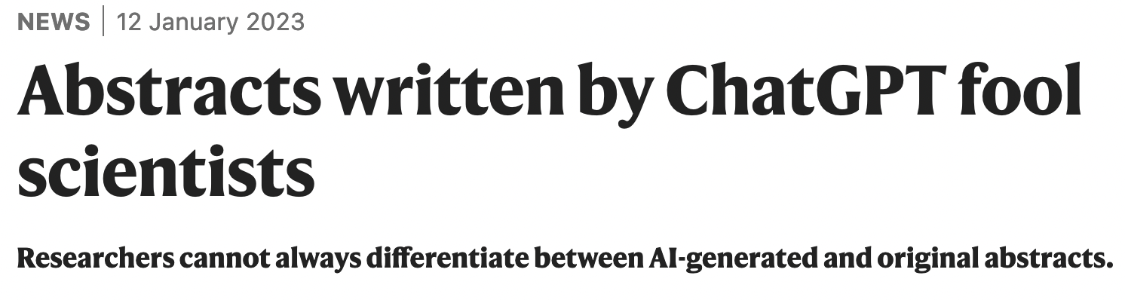
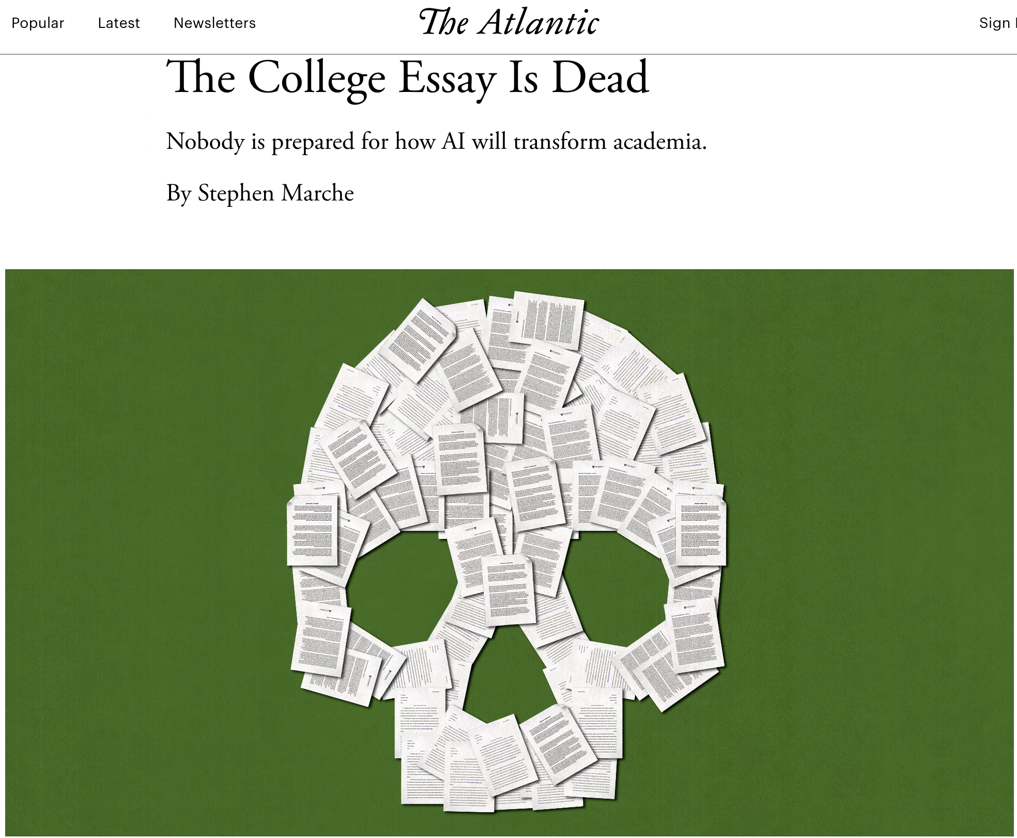
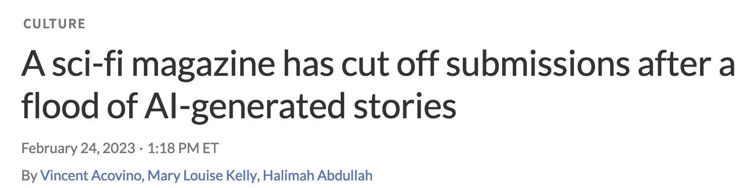
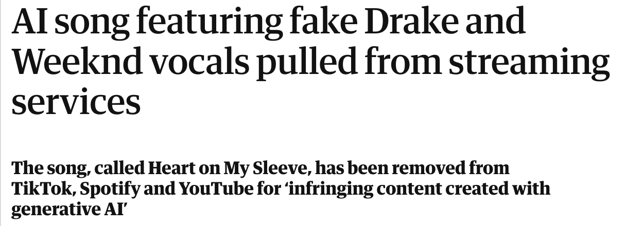
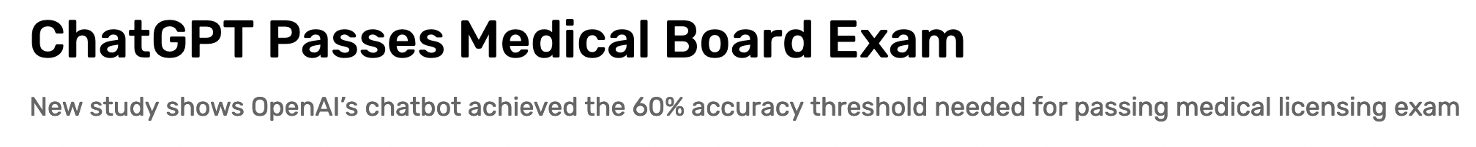
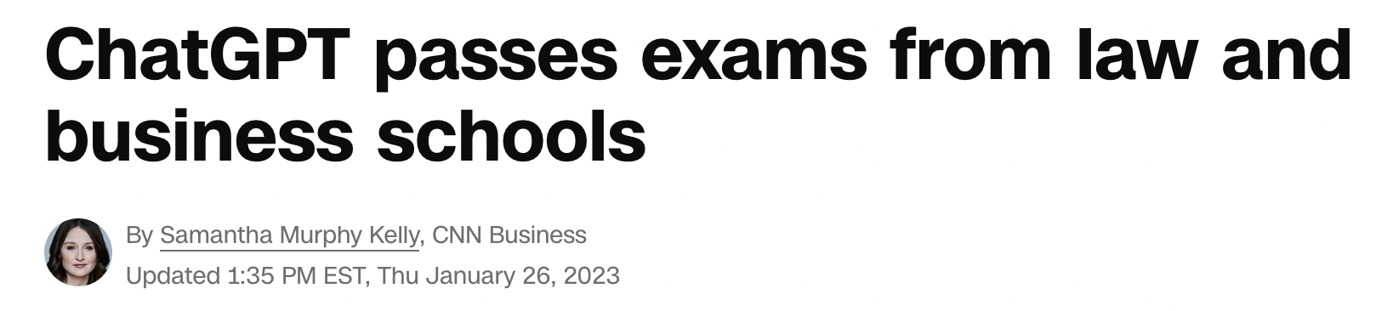
Notes:
-In the news, you aren’t paying attention to news if you haven’t heard of ChatGPT
-audience – how many folks have tried ChatGPT or derivatives?
-ChatGPT affect on education (essay is dead, passing exams), science (fake abstracts), art
-fake song with Drake and Weekend is NOT chatGPT, but the underlying technology isn’t much different

Slide 5
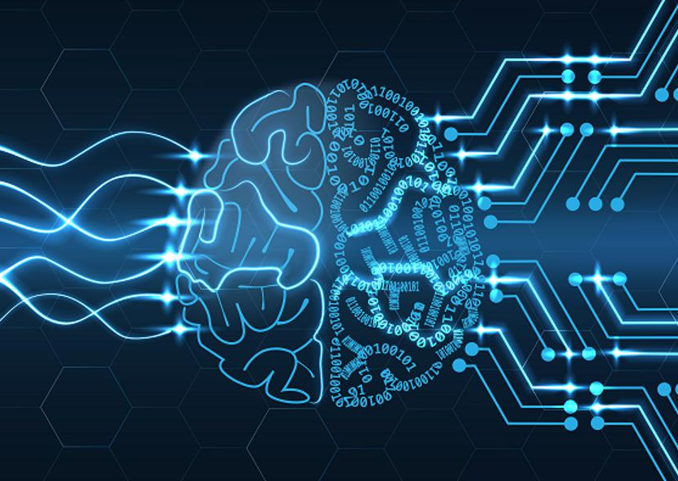
Language Model
Definition (Wikipedia)
“A statistical language model is a probability distribution over sequences of words.”
Input:
Sequence of n words
Output
P (w₁, w₂, w₃…w_{n})
Image from Forbes (https://www.forbes.com/sites/garydrenik/2023/01/11/large-language-models-will-define-artificial-intelligence/?sh=bb7b5d8b60f5
Notes:
That’s it? Yes – really!
To know what the next word is, it’s a difficult problem. Language, context, tense, semantics & syntax… lots of things

Slide 6
Language Model Taxonomy
Language Models
“Statistical” Model
Neural Models
Non-Generative Models or
Language Model Replacements
Generative Models
Notes:
Statistical Models – N-Gram models – current models are also “statistical”, we will touch on KL divergence but statistics is baked into machine learning including Deep Learning
Non-Generative Models (BERT)
We are focusing in on Generative Models in this talk
-Transformer-based, Decoder-Only, Autoregressive training, ”Casual Models”

Slide 7
Language Model Development
Statistical Models
Neural Models
Canonical examples is an N-Gram based model
Markov Assumption
Bigram, Trigram, etc… (Markov property)
Statistics learned from corpus
Never played a central role in NLP
Been around since at least the 1950s…
Emerged from the “Deep Learning” revolution in the 2010s
Initial focus on RNNs (LSTM & GRUs), now Transformers
May or may provide a probability distribution, but can learns to predict one and can be used as a “drop-in replacement” for one
Generates predictions useful for a variety of NLP tasks, “Foundational Models”
Notes:
N-Gram, word n-grams, character n-grams
-looking at co-occurrence statistics in bigrams (2 words) for example

Slide 8

Fundamentals: ChatGPT Setting the Stage
Neural Networks
Word Vectors
Transformers (Attention Mechanism)
GPT-2 / GPT-3
Architecture
Notes:
This is about 4 lectures in my course condensed into less than 20 slides
-Can at least define a few things I will be talking about during

Slide 9
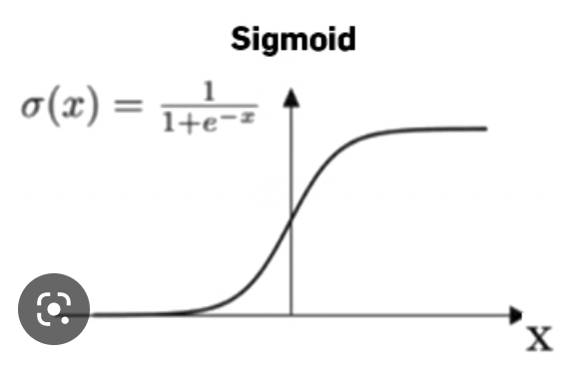
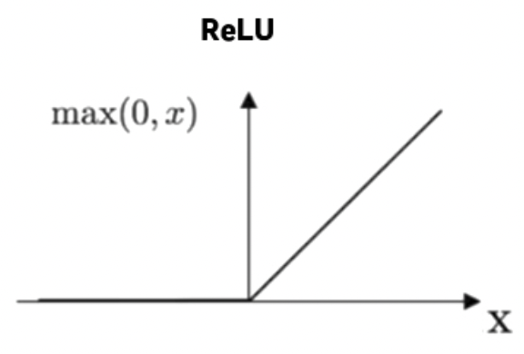
Neural Network Background
McCulloch-Pitts neuron (1943)
Simplified human neuron model that could do propositional logic
No longer relevant
”Network of small computing units, each of which takes a vector of input values and produces a single output value”
Feed-forward networks
Now Deep Learning
https://web.stanford.edu/~jurafsky/slp3/
Notes:
Neural networks are called neural because their origins lie in the McCulloch-Pitts neuron, which was a 1943 simplified model of the human neuron as a kind of computing element that could be described in terms of propositional logic. But the modern use in language processing no longer draws on these early biological inspirations and the name neural is really just a kind of historical remnant
-we still use weights and bias though, and sigmoid function
-have other functions now (Relu) CLICK, Softmax (like Sigmoid for multi-class)
2 Problems with early models – these simple models couldn’t solve any function (XOR problem)
-Fixed by multiple layers – hence Deep Learning...
-Could not effectively train these deep neural networks (backpropagation)

Slide 10
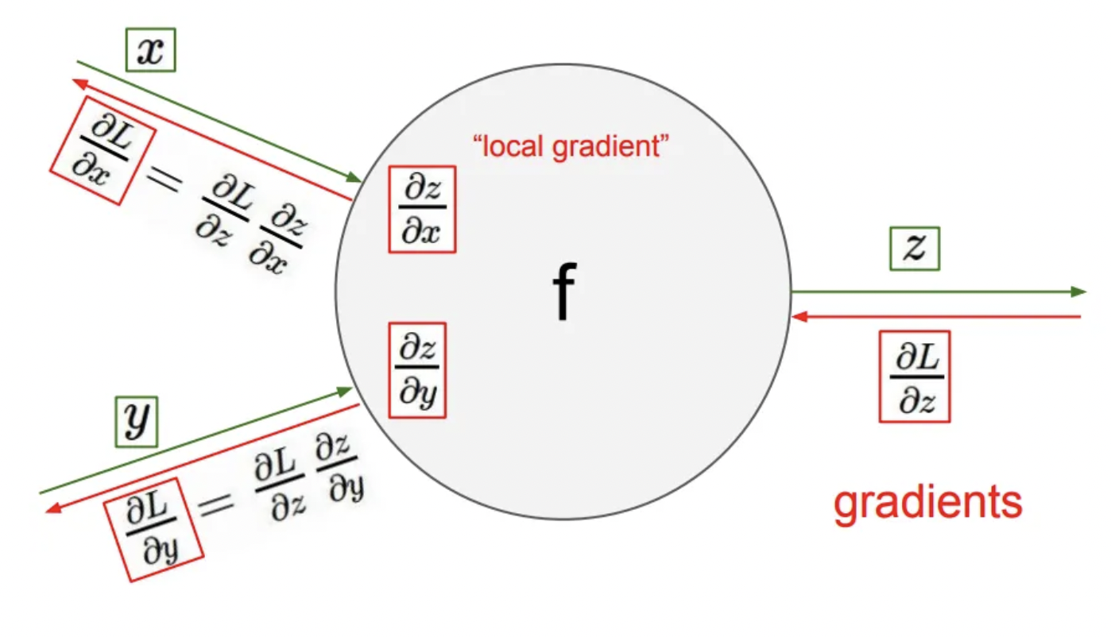
Backpropagation
https://medium.com/coinmonks/backpropagation-concept-explained-in-5-levels-of-difficulty-8b220a939db5
Notes:
This problem (efficient training of deep neural networks) was solved by Hinton by backpropagation in 1986
-Minimal explanation – just this slide and another one
-Issue is how to train/update the weights of the matrix
-for a big the loss (versus prediction) you want update weights more severely and also pick the right neurons to update
- Will take about “gradient a lot”, think of it as:
1) direction of greatest change for a multivariate function
2) vector with partial derivatives (looking at large hidden layer, it will be a matrix)
We will compute forward pass using input X and Y, going to Z then compute loss with backpropagation and attribute blame so we know how much of each weight to update

Slide 11
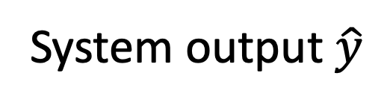
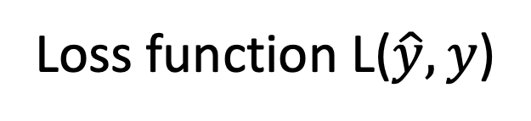
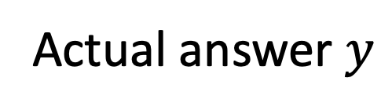
Intuition: Training a 2-layer Network
Actual answer $y$
Loss function L($\hat{y},y$)
System output $\hat{y}$
U
Backward pass
W
Forward pass
x₁
x_{n}
Training instance
Notes:
What does this look like?
The intuition of neural net training is the forward computation of the loss and the backward computation of the weight updates. Given an input x,
CLICK
we run a forward pass through the network, computing the system output y-hat. CLICK
Then we compare y-hat to the true answer y, CLICK to get a loss for this example. CLICK Then CLICK we do a backward pass through the network, computing the gradients we need to update the weights.
-aren’t any better than existing methods (GPUs help getting them to be bigger, starting getting better results)
-MLP in SciKit-Learn (no better than SVMs, linear regression in some cases)

Slide 12
Why Neural Networks and why now?
Why?
Representation
Neural networks can learn more complex linguistic representations instead of hand engineered features
Removes focus on manually derived features – learn these features directly from data
Results
Around 2011-2012 Deep Learning methods started winning contests, particularly for image processing
NLP Deep Learning methods entered their own “golden age” some years later
Why now?
Efficient backpropagation methods for deep neural networks can learn representations (1986)
Cheap GPUs and Dense Word Vectors (2010s)
Transformers / Attention Mechanism (2017)
BERT (2018)
ChatGPT (2022)
Notes:
Hinton - 1986 (Turing 2018 along with 2 other guys)
Viswani – Attention 2017
Devlin – BERT 2018

Slide 13

Word Vectors
Notes:
-new type of word representation instead of 1-hot representations
-dense vectors

Slide 14
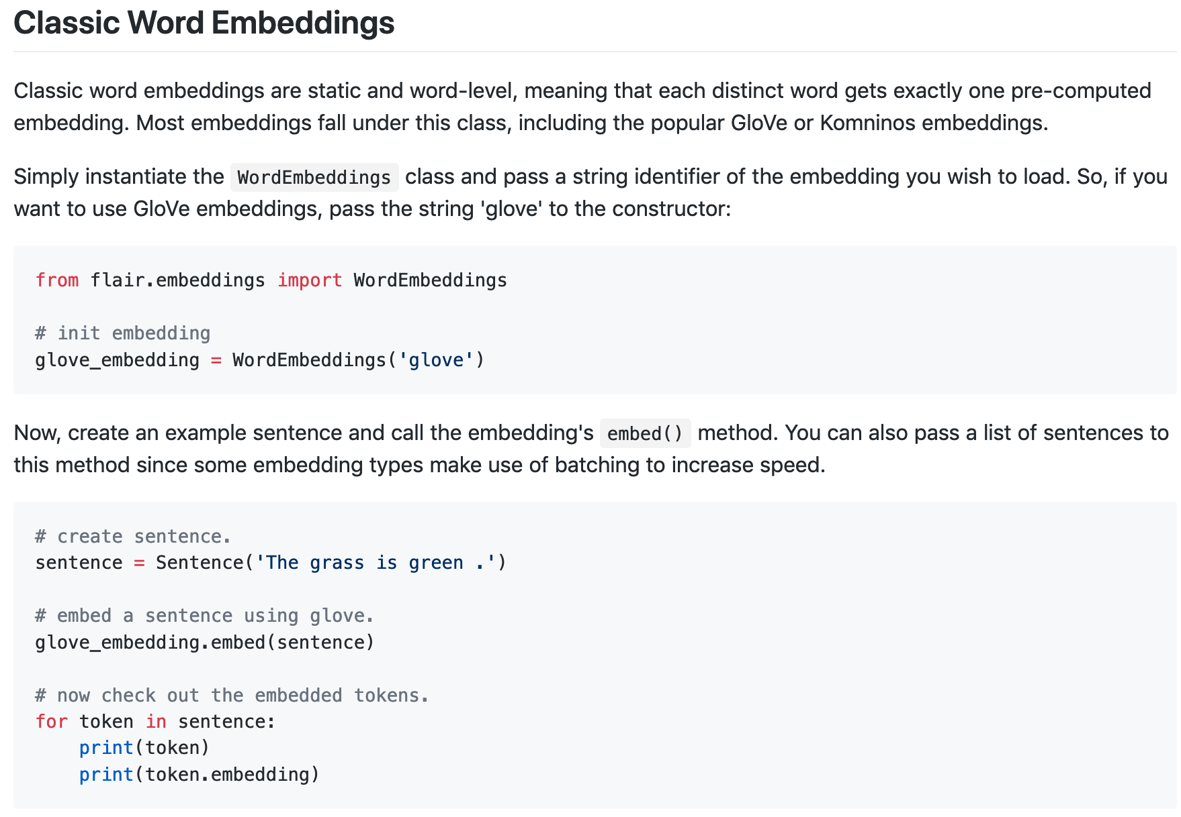
Complexity is hidden
Corpus
Tokenization scheme
What is embedding output? Scalar? Vector?
100 element dense pytorch vector
https://github.com/flairNLP/flair/blob/master/resources/docs/embeddings/CLASSIC_WORD_EMBEDDINGS.md
Notes:
-from FLAIRNLP
-”Classic word embeddings”, Glove learns from Matrix Factorization, word2vec uses neural network
-learns from context, but is not contextual – one embedding per word
-need to read some documentation to know what you are getting, complexity is hidden
-is it appropriate for biomedical documents? Social media?

Slide 15
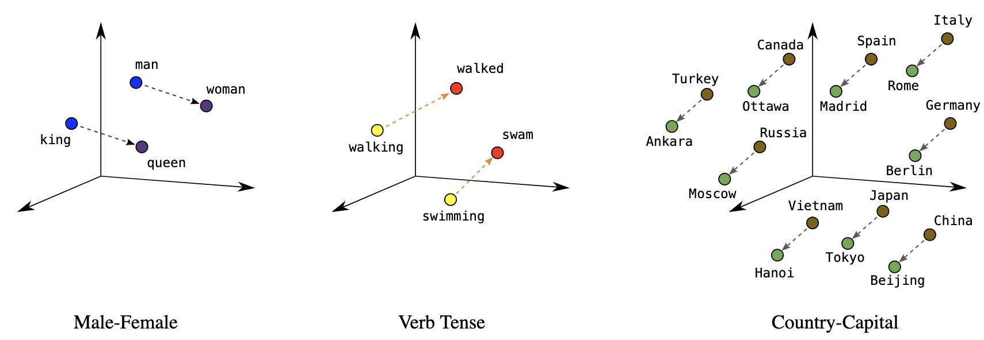
https://developers.google.com/machine-learning/crash-course/embeddings/translating-to-a-lower-dimensional-space
Notes:
Vectors have this compositionality property based on how they are trained
-Wanted this slide to address poorly written articles in the popular press say “just statistics on words”, don’t know what they really mean
-not true, emotional components, historical components, style components, how much a word has to do with surgery – everything can be encoded
-a word vector of size 2048 (2K numbers) may understand about the historical relationship of surgery to gender better than a practicing surgeon in some large context (at least it can numerically quantify that based on what corpus it was trained on)
-not apparent from tutorial, but you are loading up word vectors when you are loading those models

Slide 16

Transformers
Notes:
Not the first to use this Designer suggested picture…
-Discuss in GPT-2/GPT-3 context

Slide 17
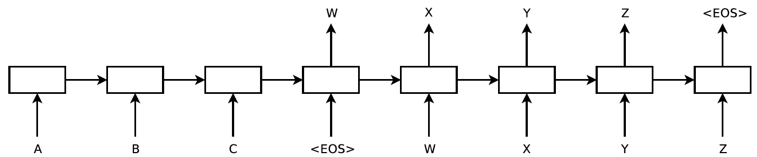
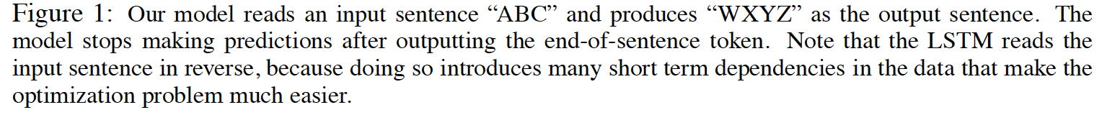
Transformers: Replacement for RNNs in Sequence-to-Sequence Models
DECODER
<EOS> == End of Sentence
ENCODER
Figure 1 from original paper https://arxiv.org/pdf/1409.3215.pdf
Notes:
Left side is the encoder = Source language (no output). (Literally it is going to ENCODE a representation of that input sequence)
Used for language translation
CLICK
Right side is decoder = Outputs target language, decodes representation generated by the encoder
Recurrent Neural Network - takes its output as input, some state is transferred as it moves through the sequence

Slide 18
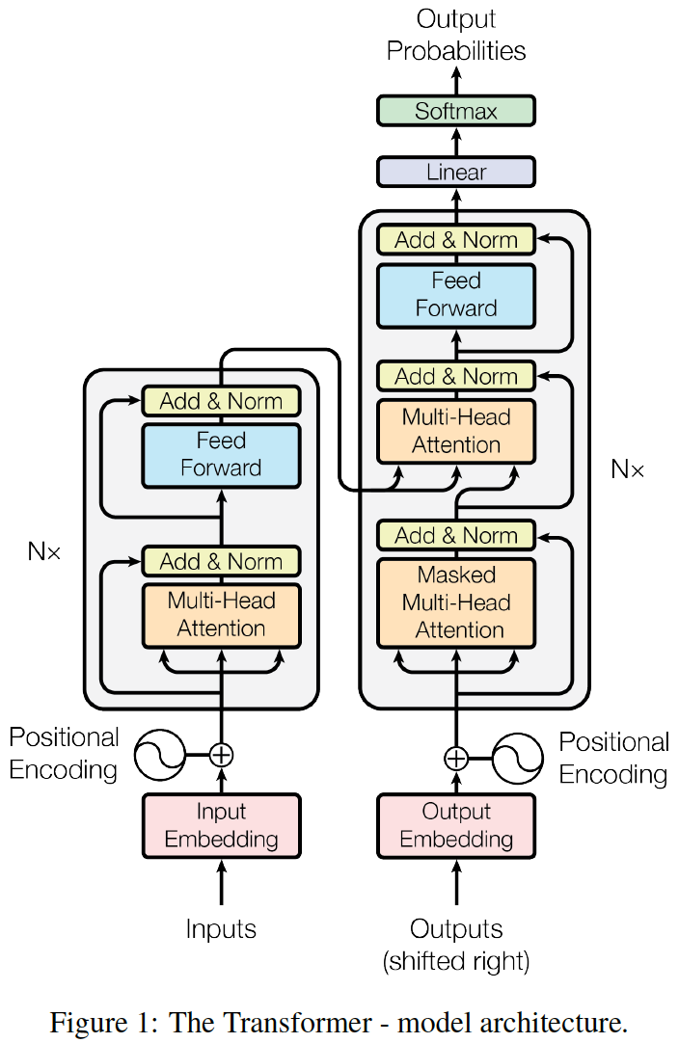
Attention is all you need: Overview
Feed Forward
Fully connected feed forward network Encoder is learning best representation of input for that layer
Add & Norm
LayerNorm(x + Sublayer(x ))
Output dimension size is d_{model} = 512
Multi-layer Decoder
Extra sublayer for masking (look-ahead mask)
Multi-layer Encoder
(N=6 for paper)
Each layer has 2 sublayers, Multi-Head Attention and Feed Forward
“training for 3.5 days on eight GPUs, a small fraction of the training costs of the best models from the literature”
Encoder/Decoder
Sublayers haves:
Residual Connections
Layer Normalization
Not RNN, must encode position of input token in text
Notes:
-Since replacing RNN, needs to know position, GPT-3 takes absolute position (--2047) and passes through sinusoidal functions, each with a different frequency.
-Will discuss Multi-Head attention next 2 slides
Normalization: Instead of normalizing over features (batch normalization), normalize over the entire layer.
DECODER (like Encoder)
-getting input from encoder
-2 types of masking (padding, 512 cutoff and look-ahead mask)
“This masking, combined with fact that the output embeddings are offset by one position, ensures that the
predictions for position i can depend only on the known outputs at positions less than i.”
-attention is happening all at once, encoded representation is over the entire sequence
-Done to allow training of Deep Networks Layer

Slide 19
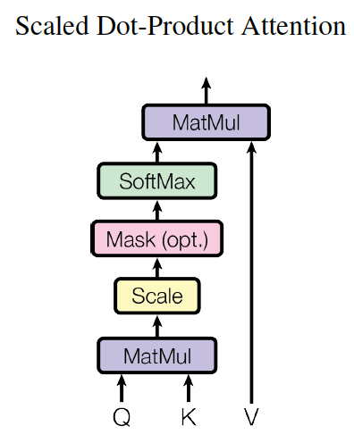
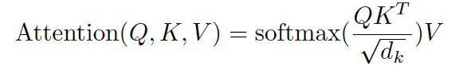
Scaled Dot-Product Attention
Attention Weights
We have an intuition of what attention is, but how is it computed?
Q is a query matrix
Vector representation of one word in the sequence
(In practice all queries go in at once)
Masking needed in decoder
K is key matrix
Vector representation of all the words in the sequence
Queries and keys of dimension d_{k}
V is values, like Q it represents all words in the sequence
The “compatibility function” of the query with the corresponding key transforms V
Scale
All matrices multiplied by input X
From Figure 2 https://arxiv.org/abs/1706.03762
Notes:
-Some query Q would be the first word in your sentence/sample, would compute attention with ALL keys
-Matrix multiply to compute attention
-Scaling, divide by root dK (don’t want large values to mess with later softmax, big values, small gradients)
--Multiply by V, as basically computed the attention mask
-attention weights are just dot product of query and key divided by scaling factor. ( square root of 64 = 8, not sure why square root, more stable to avoid too small numbers?)

Slide 20
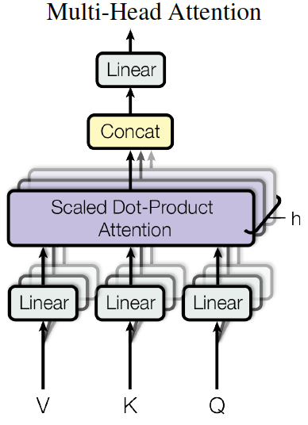
Multi-Head Attention
Could restrict attention with scaled dot product, but they project V, K and Q to learn different representations
Projected to d_{k,} d_{k and} d_{v} dimensions
Project h times, where h is # of heads
Projection is learned in training
https://arxiv.org/abs/1706.03762
Notes:
Intuition – key and query may focus all the attention on that current word, want to learn what “it” is referring to – not just focus on “it”
Nothing forces each head to learn something different, but in practice, that is what happens

Slide 21
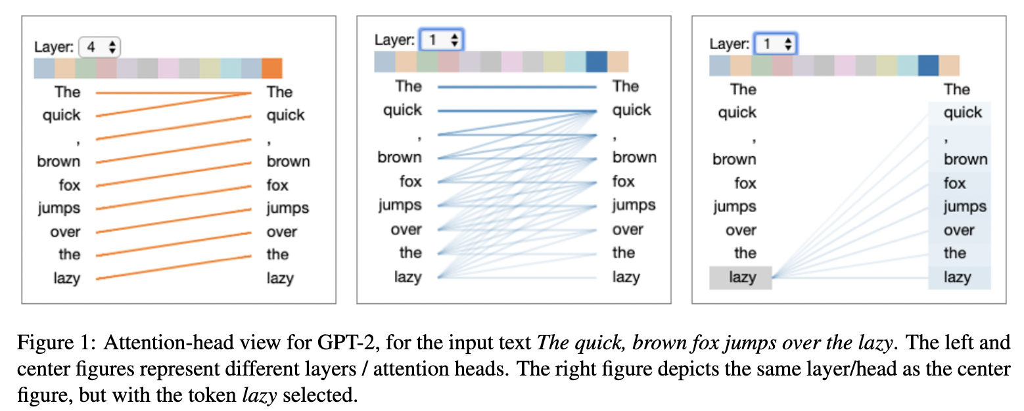
Vig, Jesse. "A multiscale visualization of attention in the transformer model." arXiv preprint arXiv:1906.05714 (2019).
Notes:
Attention visualized, layer 4 looks to be attending to the previous word
Layer 1 looks at all previous words
Layer that appear to focus on dependency relations, etc…

Slide 22

GPTs

Slide 23
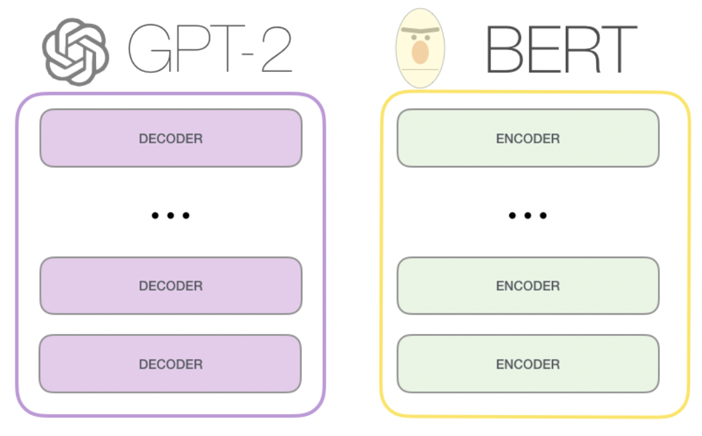
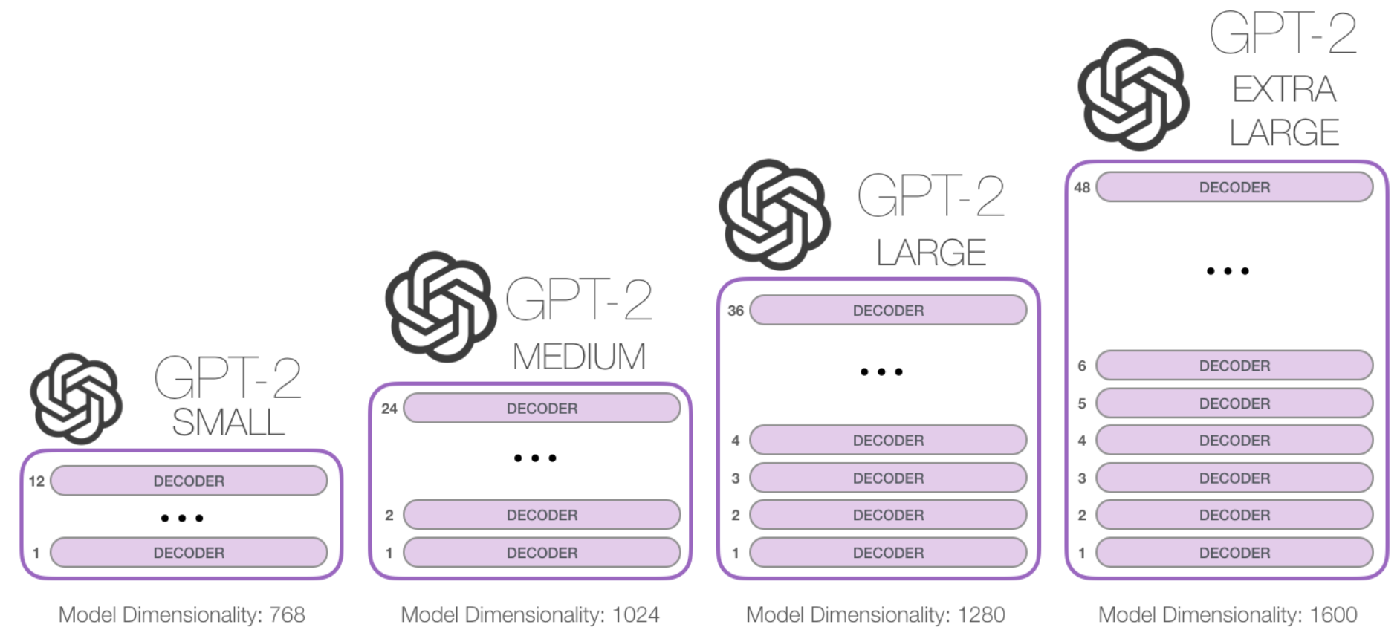
https://jalammar.github.io/illustrated-gpt2/
Notes:
-Good website to understand GPT-2 (same as GPT-3 essentially)
-only decoder, no encoder (encoder/decoder makes sense for say language translation, not for doing things like language modelling
-this decoder is just like encoder except it has masked self-attention

Slide 24
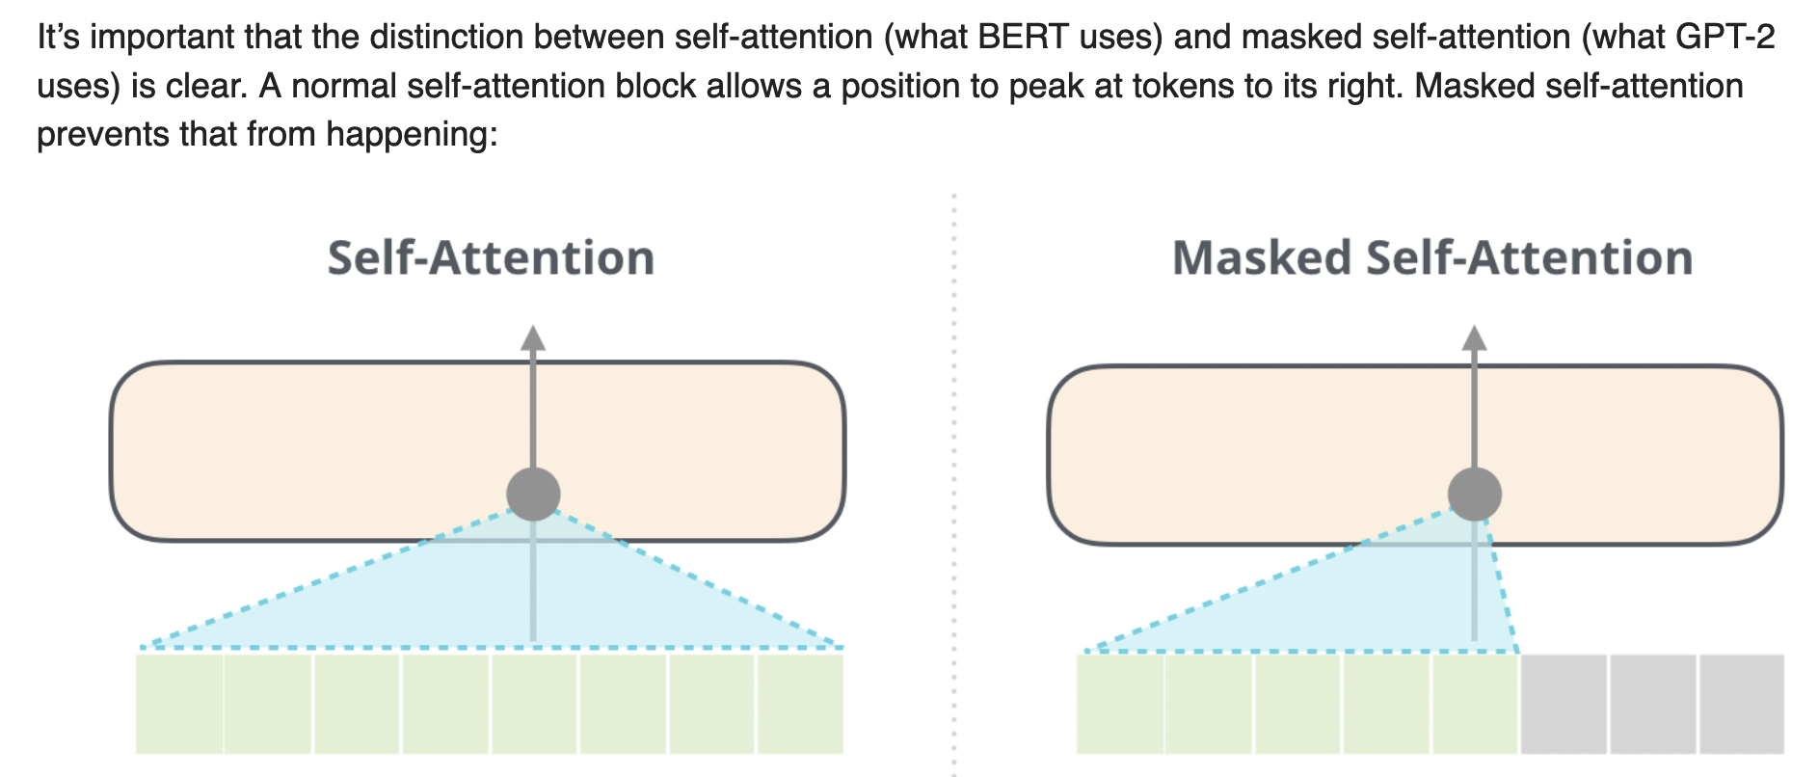
Notes:
BERT better at many tasks versus equivalent sized decoder only model when you need to look at entire context
Autoregressive function needed for generation
BERT can’t really generate text (masked language model)
-BytePairEncoding for vocabulary (has every character in the alphabet, adds in most common words until fixed size is reached) – handle rare words well

Slide 25
Early GPT Models
 | GPT-1 | GPT-2 | GPT-3
Release Date | 2018 | 2019 | 2020
Parameters | 117M | 1.5B | 175B
Heads | 12 | 48 | 96
Context Window Token Size | 512 | 1024 | 2048
Hidden Layer Size | 768 | 1600 | 12288
Batch Size | 64 | 512 | 3.2M
Training Data Size | 5GB | 40GB | 45TB
Notes:
What’s missing?
So, Models referred to as "GPT 3.5" series is a series of models that was trained on a blend of text and code from before Q4 2021. The following models are in the GPT-3.5 series:
code-davinci-002 is a base model, so good for pure code-completion tasks
text-davinci-002 is an InstructGPT model based on code-davinci-002
text-davinci-003 is an improvement on text-davinci-002
GPT-3 is just bigger GPT-2 (more or less) that made zero-shot/few-shot more famous because it was good at it

Slide 26

ChatGPT

Slide 27
ChatGPT…
InstructGPT (2022)
ChatGPT (2022)
OpenAI published paper predating ChatGPT
Contains RLHF details
Hired 40 contractors to generate data
We know very little
No paper
No model
No data
Large (10X) expensive data set
RLHF similar to InstructGPT but with some (?) modifications
Ouyang, Long, Jeffrey Wu, Xu Jiang, Diogo Almeida, Carroll Wainwright, Pamela Mishkin, Chong Zhang et al. "Training language models to follow instructions with human feedback." Advances in Neural Information Processing Systems 35 (2022): 27730-27744.
Notes:
I’m not really going to talk about ChatGPT, I’m going to talk about the piece we know about that helps make ChatGPT work -RLHF
-big scale, 40 contractors
Contractors from Upwork, ScaleAI, screened folks to get people who are good at identifying harmful content

Slide 28
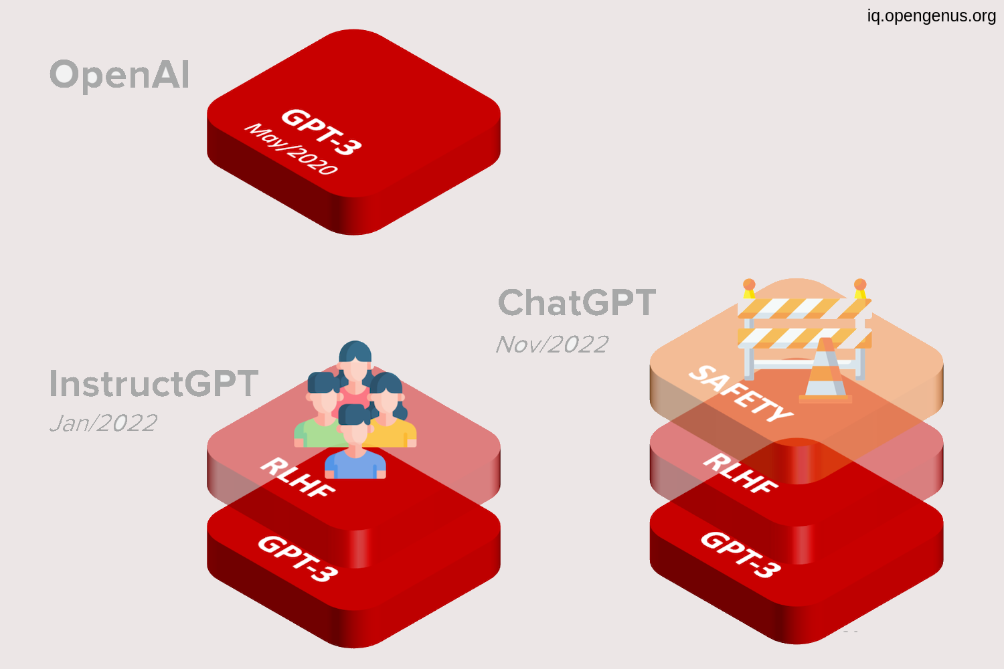
ChatGPT
https://iq.opengenus.org/gpt-3-5-model/
Notes:
Main modification is for safety
We will talk about what they mean by that, essentially extra RLHF with different criteria

Slide 29


Review: Reinforcement Learning
A policy in this context is a function that maps a state to an action
This function can be anything…
State
Reward
Action
Notes:
Been around for awhile, Alpha GO is big one, Protein Folding
Predates any sort of deep learning, used to have humans label actions that an agent took as good/bad (Reward model and Policy were then same)
Nothing to do with Language Models are all in inception
Different from unsupervised (No labelled data) or supervised machine learning (Labelled data)
Learn from mistakes, usually trying to optimize some sort of score
RLHF will use basically all 3 types of machine learning, unsupervised (language model), fine-tuning on supervised (for whatever), then reinforcement learning
Many ways to do reinforcement learning, Markov Decision Processes are classic but there are many others, and I can’t provide a good overview. Will focus on InstructGPT/ChatGPT here

Slide 30
LLM Training Methods
Fine-tuning
Finetuned
LLM
Prediction on some fine-tuned task/s
Supervised
training data
RLHF
RLHF Model
Prediction on wide range of tasks
Pretrained Large Language Model
Prompts
Reward Model
“Few-shot” prediction on any task
Prompt engineering
minimal data
True “Zero-shot” prediction on any task
No prompt tuning and no extra data
Notes:
3 Types of Traditional Learning, what they look like
CLICK
RLHF
To clarify, instruction training does do full fine-tuning

Slide 31
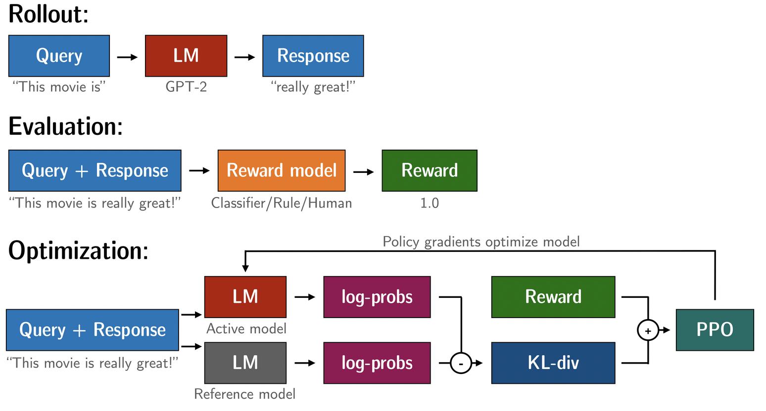
TRL - Transformer Reinforcement Learning
Begin TRL tutorial!
https://github.com/u-brite/rlhf_attis2023
Converted python script to Jupyter Notebook I could actually run in Google Colab
No cheaha today!
https://github.com/lvwerra/trl
Notes:
Showing TRL slide
-we will use TRL in tutorial, but look at InstructGPT paper for understanding of ChatGPT
-components I talked about on previous slide
Rollout - Initial model
Evaluation - Reward
Optimization - Tricky part (describe)
-Your standard language model LM, going to be used twice

Slide 32
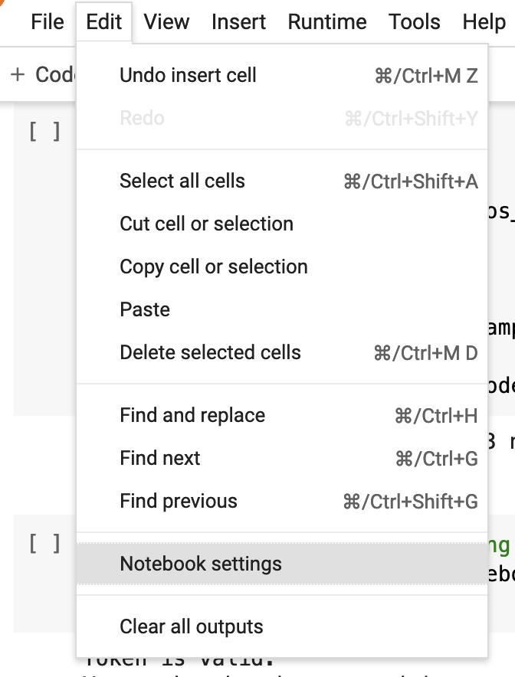
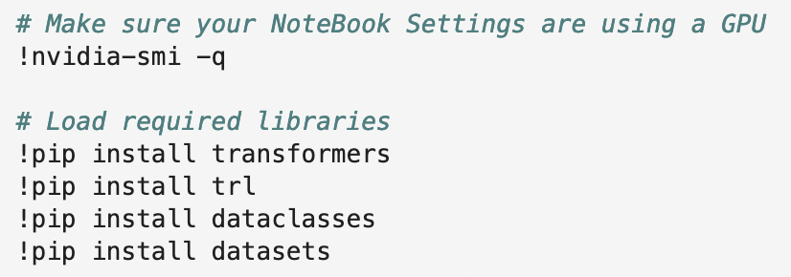
Tutorial Setup
Notes:
Make sure you have a GPU!
Load in libraries

Slide 33
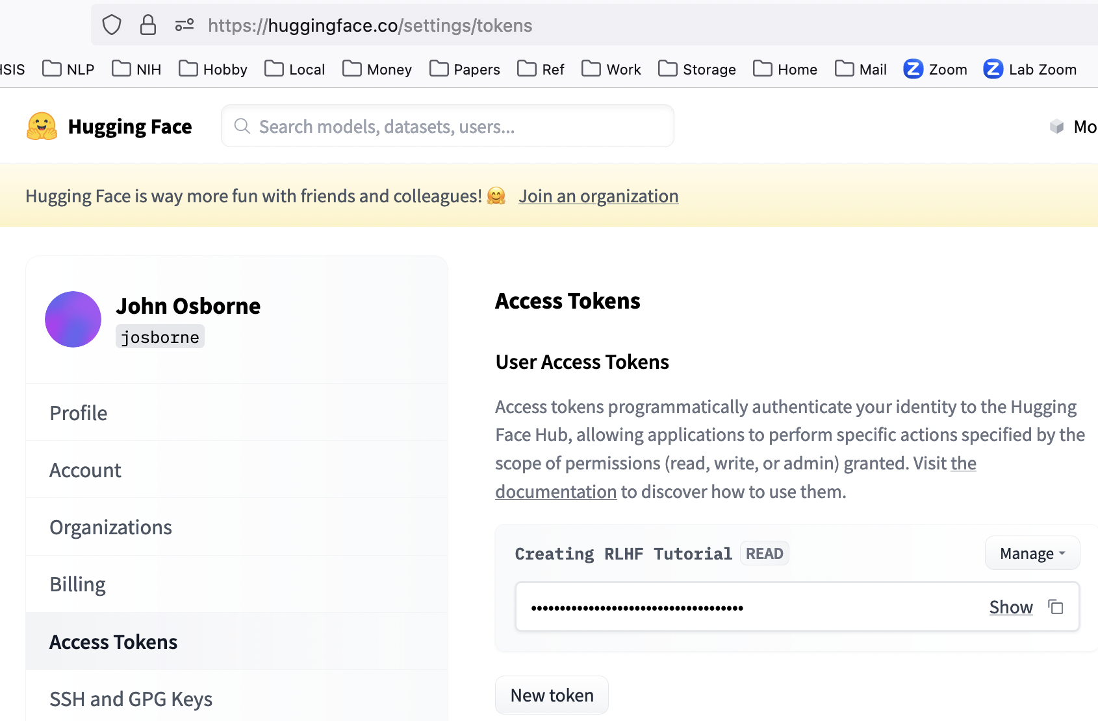
Get a huggingface account if you don’t have one already
You will need to copy in your token to access the models later in the tutorial
https://huggingface.co/welcome

Slide 34
RLHF: Reinforcement Learning with Human Feedback
Technical Motivation
LLM Alignment Problem
Language models typically trained with next token prediction loss as measured by cross entropy loss function
Not ideal metric, score is dependent on tokenization vocabulary, ignores synonyms, etc…
Want a more human metric (BLEU, ROUGE), actual humans even better!
“the language modeling objective used for many recent large LMs—predicting the next token on a webpage from the internet—is different from the objective “follow the user’s instructions helpfully and safely””
Ouyang, L., Wu, J., Jiang, X., Almeida, D., Wainwright, C., Mishkin, P., ... & Lowe, R. (2022). Training language models to follow instructions with human feedback. Advances in Neural Information Processing Systems, 35, 27730-27744.
https://huggingface.co/blog/rlhf
Notes:
Example Corpus: “P53 guards the genome”
Round 1:
LM1: Pizza guards the genome (incorrect pizza)
LM2: TP53 guards the genome (incorrect T), not TP token in English (assume)
-human would say LM2 was closer to truth

Slide 35
Alignment Problem: Commercial Motivations
Less Toxic
More Helpful and Honest
Large language models are not just large in terms of parameter size, they are also trained on large amounts of text
“the training data has been shown to have problematic characteristics”
Downstream users of LLM don’t care how well the LLM performs on next word prediction
Humans are users and humans want helpful models
Some folks may be surprised but not all information on the Internet is true!
Bender, E. M., Gebru, T., McMillan-Major, A., & Shmitchell, S. (2021, March). On the Dangers of Stochastic Parrots: Can Language Models Be Too Big?🦜. In Proceedings of the 2021 ACM conference on fairness, accountability, and transparency (pp. 610-623).
Notes:
ChatGPT focues on less Toxic (our tutorial would focus on toxicity as well)
-InstructGPT focused on helpful and honest
-toxic is a big problem
-large means anything folks can get their hands on with some filtering
-” The Colossal Clean Crawled Corpus [ 107], used to train a trillion parameter LM in [ 43 ], is cleaned, inter alia, by discarding any page containing one of a list of about 400 “Dirty, Naughty, Obscene or Otherwise Bad Words””

Slide 36

How does RLHF work to solve this problem? Ask ChatGPT?!

Slide 37
Can you explain how RLHF works for language models like I am five?
Sure! So, imagine you're playing a game where you have to make up a story. Every time you say a good sentence, your friends give you a treat. But if you say something silly or nonsensical, you don't get a treat.
Now, imagine you have a robot friend who's learning how to play this game too. At first, the robot might not know what to say, but it can watch you play and learn from your example.
But what happens when the robot encounters a word it doesn't know, like "abracadabra"? It might get stuck and not know what to say next.
That's where RLHF comes in. It's like the robot has a teacher who tells it when it's doing a good job and when it's not. The robot can learn from its mistakes and get better at making up stories, even when it encounters new or unusual words.
So, RLHF is a way for the robot to learn how to generate sentences by combining different types of models and getting feedback from its "teacher" in the form of rewards or punishments. This helps the robot get better at generating sentences and telling stories, just like you get better at a game when you practice and get feedback from your friends.
Notes:
It’s extremely creative here, not sure if it works for a 5-year-old but it accurate insofar as it is a high level explaination
-tone of article also very appropriate for 5-year-old
-unused slide section I have one for undergraduates as well

Slide 38
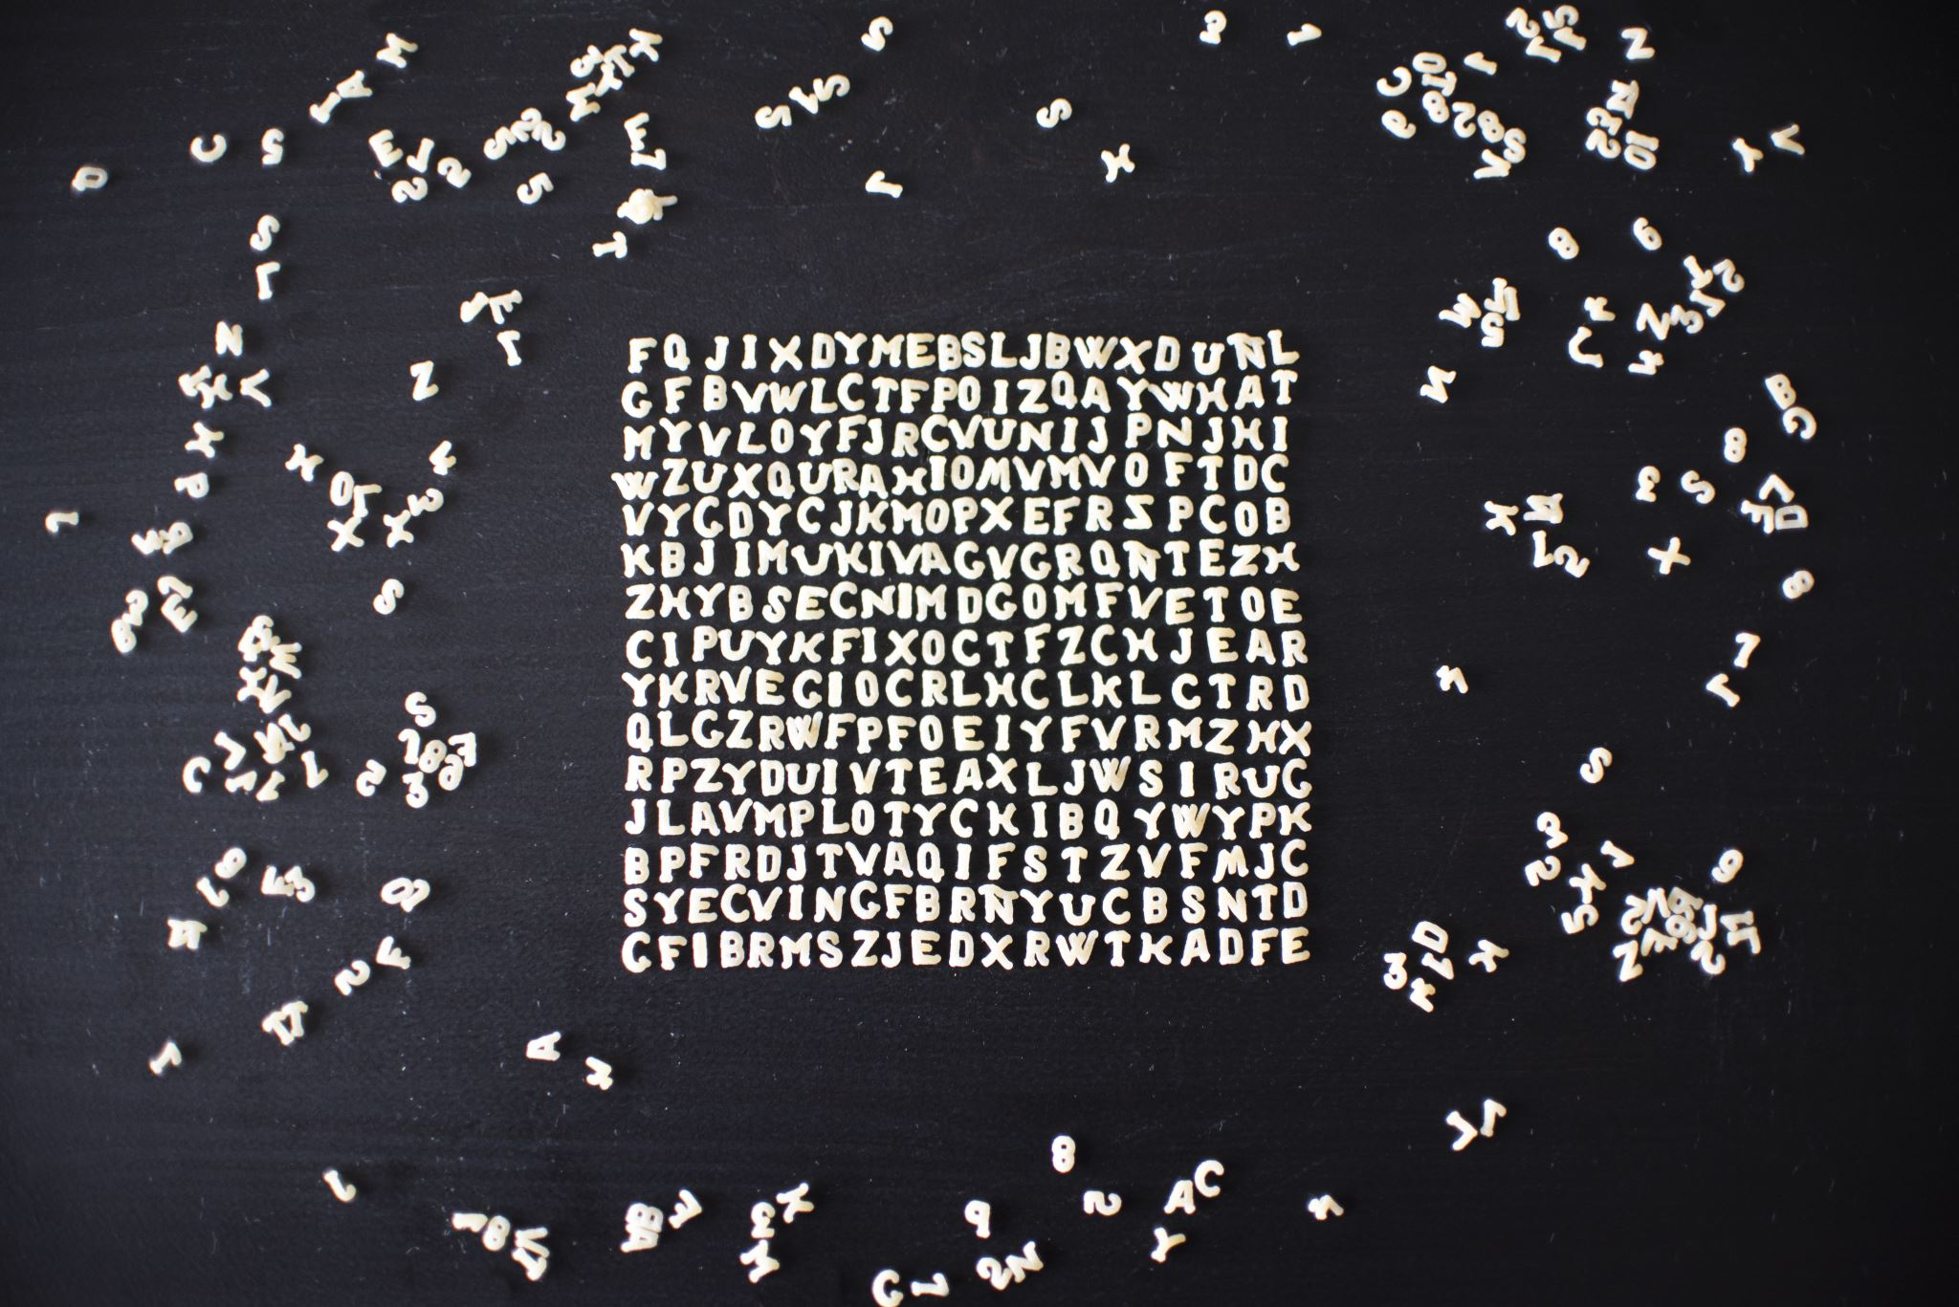
Step 1: Initial Model

Slide 39
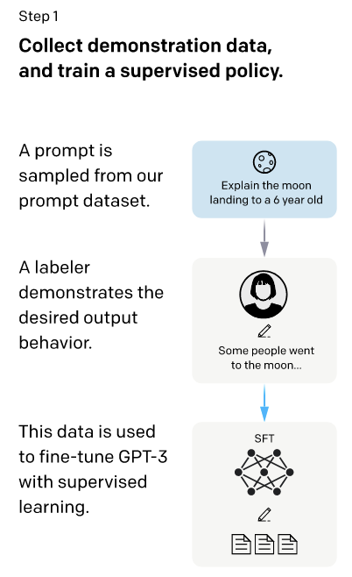
{ "instruction": "Answer this question truthfully",
"input": "What are the symptoms of Anaphylaxis?",
"output": "Symptoms develop rapidly, often within seconds or minutes. They may include the following:\nAbdominal pain or cramping Abnormal (high-pitched) breathing sounds Anxiety Confusion Cough Diarrhea Difficulty breathing Difficulty swallowing Fainting, light-headedness, dizziness Hives, itchiness Nasal congestion Nausea, vomiting Palpitations Skin redness Slurred speech Wheezing" },
https://raw.githubusercontent.com/kbressem/medAlpaca/main/medical_meadow_small.json
https://arxiv.org/pdf/2203.02155.pdf
Notes:
Prompts in InstructGPT come from submissions from website, they also create some prompts themselves based on some unknown criteria
-I show some medical prompts from medAlpaca
-supervised learning/fine-tuning gets their baseline without RLHF
-traditional labelled data set
-since they don’t share their data, I will show some from Medical Meadow (exams)

Slide 40

Name | Source | n | n included in training
Medical Flashcards | medalpaca/medical_meadow_medical_flashcards | 33955 | 33955
Wikidoc | medalpaca/medical_meadow_wikidoc | 67704 | 10000
Wikidoc Patient Information | medalpaca/medical_meadow_wikidoc_patient_information | 5942 | 5942
Stackexchange academia | medalpaca/medical_meadow_stack_exchange | 40865 | 40865
Stackexchange biology | medalpaca/medical_meadow_stack_exchange | 27887 | 27887
Stackexchange fitness | medalpaca/medical_meadow_stack_exchange | 9833 | 9833
Stackexchange health | medalpaca/medical_meadow_stack_exchange | 7721 | 7721
Stackexchange bioinformatics | medalpaca/medical_meadow_stack_exchange | 5407 | 5407
USMLE Step 1 | medalpaca/medical_meadow_usmle_self | 119 | 92 (test only)
USMLE Step 2 | medalpaca/medical_meadow_usmle_self | 120 | 110 (test only)
USMLE Step 3 | medalpaca/medical_meadow_usmle_self | 135 | 122 (test only)
MEDIQA | original, preprocessed | 2208 | 2208
CORD-19 | original, preprocessed | 1056660 | 50000
MMMLU | original, preprocessed | 3787 | 3787
Pubmed Health Advice | original, preprocessed | 10178 | 10178
Pubmed Causal | original, preprocessed | 2446 | 2446
ChatDoctor | original | 215000 | 10000
OpenAssistant | original | 9209 | 9209
https://github.com/kbressem/medAlpaca
Notes:
Reference Alpaca later, there seems to be a thing for the camel family in RLHF (discuss Llama and Alpaca later)
-Creative sourcing of prompts. Where can I find precious prompt data that I can use to do RLHF.
-Balance training
-some freely available data here... (medical meadows json file)

Slide 41
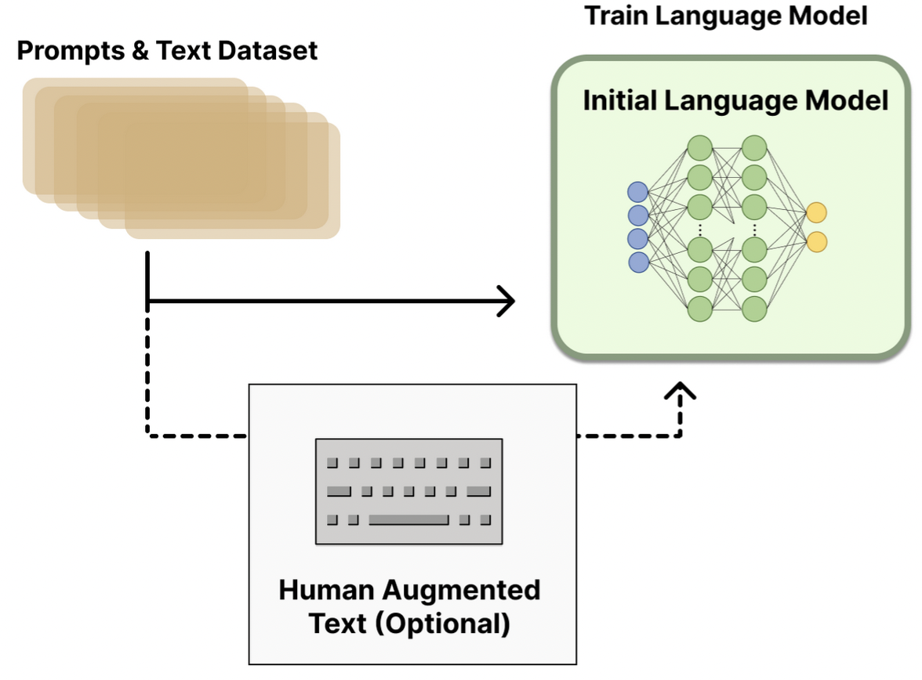
Human augmented text is optional for original model, but fine-tuning on it likely provides a better starting point
Initial language model can be any model
In the tutorial we will skip this step and use gpt-neo-1.3B directly
model_name: Optional[str] = field(default="EleutherAI/gpt-neo-1.3B", metadata={"help": "the model name"})
https://huggingface.co/blog/rlhf
Notes:
This instructGPT training - is optional
-can use any model
Supervised fine-tuning (SFT) is another name for this process
This initial language model is still doing text input (prompt) and text output based on what humans think a good answer is…

Slide 42

Step 2: Reward Model

Slide 43
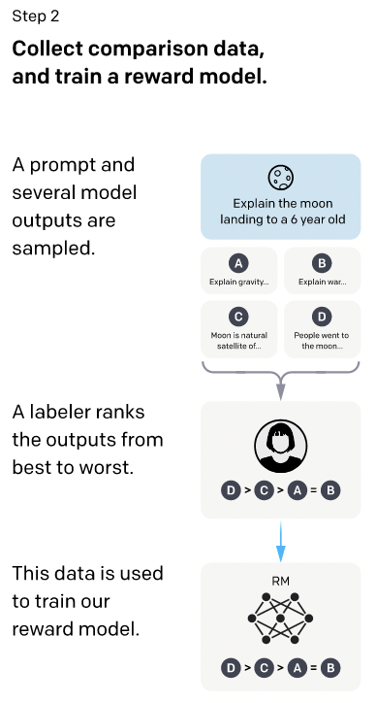
Unclear where InstructGPT prompt data set is derived from…
“we collect a dataset of human-labeled comparisons between outputs from our models on a larger set of API prompts”
Prompt response is generated by existing models like GPT-3
Labelers assign scalar values to model outputs – these are “ranks” or “scores” for the reward model to be trained
Ranking allows for comparison and better scores (4-9 options available)
https://arxiv.org/pdf/2203.02155.pdf
Notes:
Previously we were sampling prompts and annotators were writing the answers
Now they don't write the answers, they rank them
Much easier for labelers to just assign score
Reward model train with all these input prompt data based on human feedback, it was GPT-3 that was fine-tuned
Trained is just fine-tuned here

Slide 44
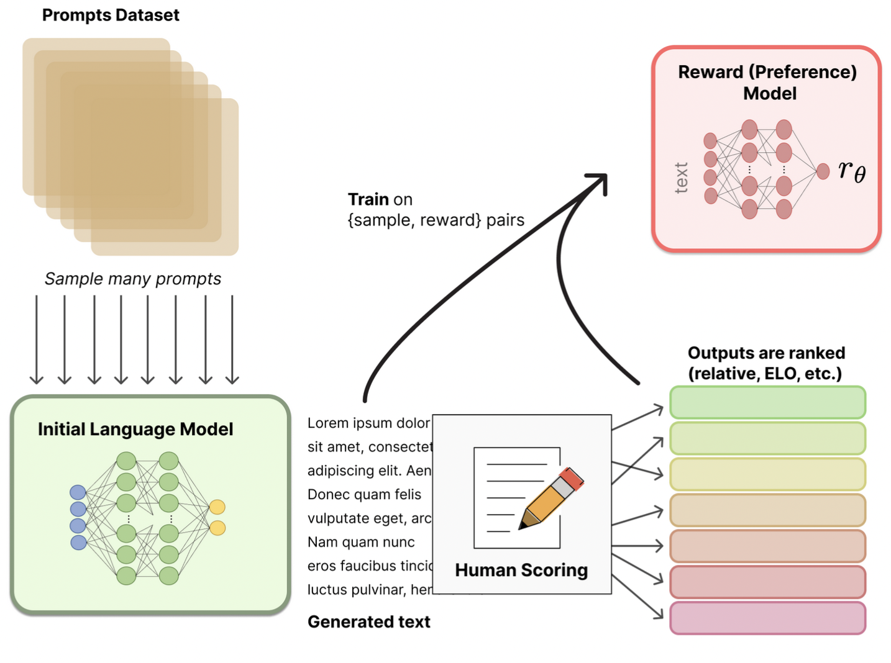
Human scoring can be anything that generates a scalar
Reward model takes in text sample (prompt + generated text) and outputs a reward score (scalar)
Size of reward model can be large or very large
6B worked better than 175B for InstructGPT
https://huggingface.co/blog/rlhf
Notes:
-Ranking for InstructGPT, but really can be anything that generates a Scalar
-Not clear how big model should be relative to original model, some variation
-InstructGPT annotators had 72% agreement -77% agreement (2 rounds of hiring, different labelers)
-So now we have 2 models, a LLM that we fine-tuned in step 1 to generate text and this reward model which can assign human preference scores to generated text

Slide 45
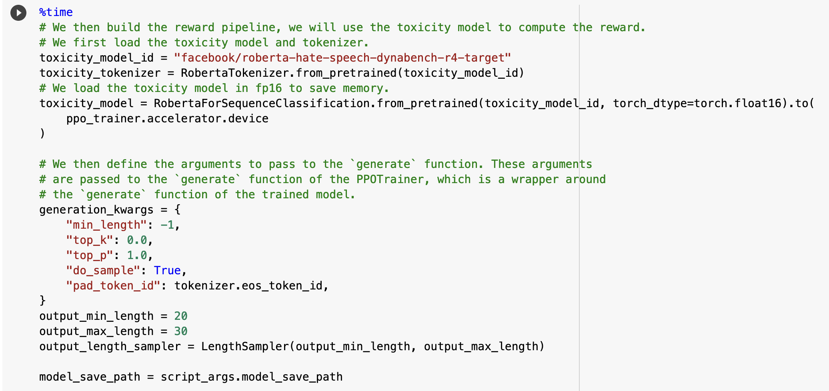
Tutorial Reward Model
Notes:
Loading our hate detection model from pretrained
Define generation
-top_k hyperparameter, let’s you pick from shortlist of most likely tokens
-top_p hyperparameter, dynamic pick all tokens the smallest possible set of words whose cumulative probability exceeds the probability p.

Slide 46
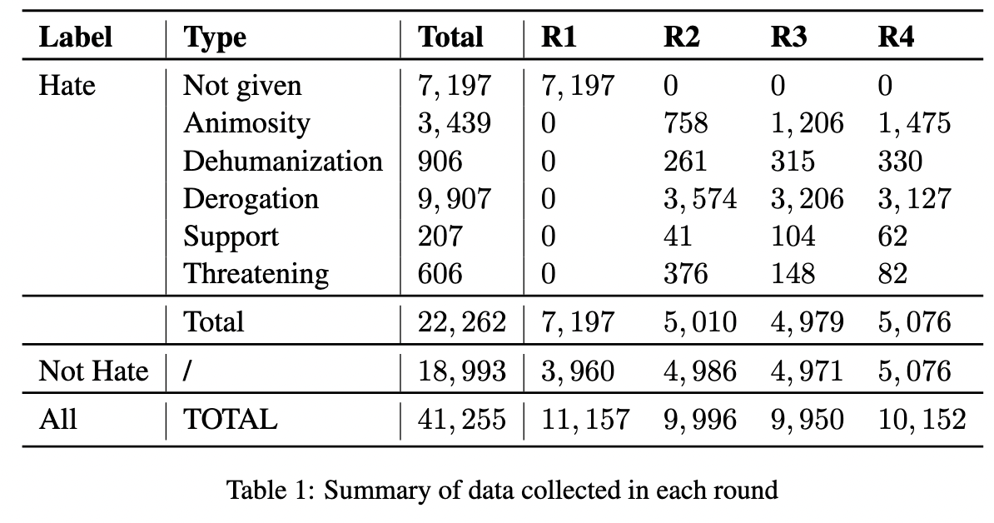
Tutorial Reward Model Training Data
Vidgen, Bertie, Tristan Thrush, Zeerak Waseem, and Douwe Kiela. "Learning from the worst: Dynamically generated datasets to improve online hate detection." arXiv preprint arXiv:2012.15761 (2020).
https://huggingface.co/facebook/roberta-hate-speech-dynabench-r4-target
Notes:
Binary hate only, using 0 and 1
Classes not used
R1 is first round of annotation, etc…

Slide 47

Step 3 - Optimization
Notes:
Hardest, most difficult to understand step

Slide 48
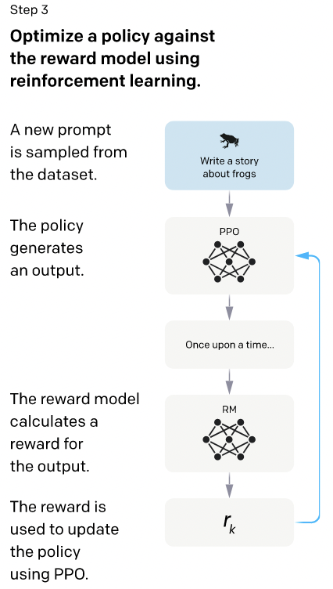
Our data set will be RealToxicityPrompts
Policy updating is just fine-tuning the language model with help from the reward model
Policy is language model with input (prompt) and output (response or continuation) of text
Action is output tokens from vocabulary
State of environment is input prompt
State
Action
Reward
https://arxiv.org/pdf/2203.02155.pdf
Notes:
State or environment is the input prompt
PPO (Language Model) generated response or continuation is the Action
Reward is computed by our model
PPO (Language Model) gets updated (more details on that)

Slide 49
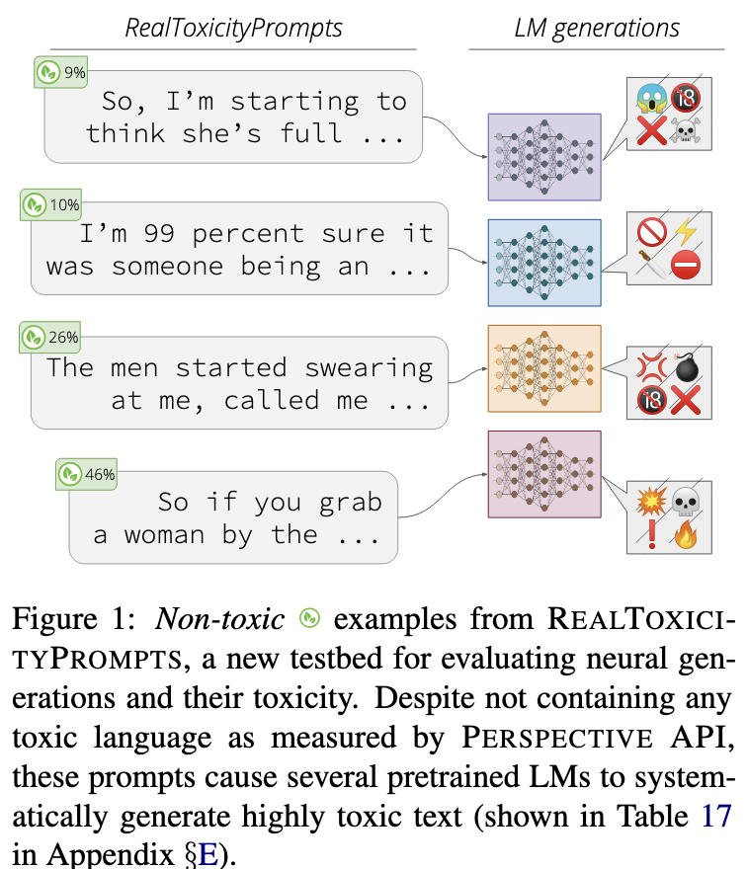
PROMPT Database
RealToxicityPrompts
We will use this data and sample prompts in order to get our language model to generate toxic text
Toxicity scores generated by Perspective API https://github.com/conversationai/perspectiveapi
Gehman, Samuel, Suchin Gururangan, Maarten Sap, Yejin Choi, and Noah A. Smith. "Realtoxicityprompts: Evaluating neural toxic degeneration in language models." arXiv preprint arXiv:2009.11462 (2020).
Notes:
Notice prompts don’t contain any toxic text themselves…
Perspective API is commercial software

Slide 50
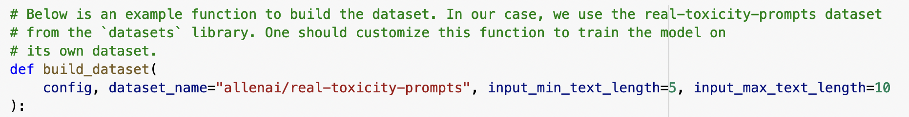
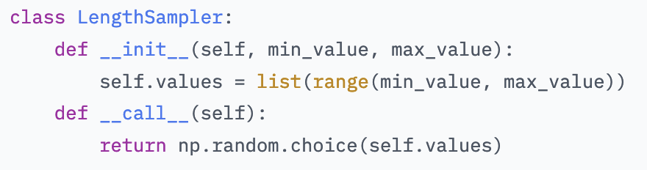
Load in real-toxicity-prompts
Confine input length to 30-40 tokens, random uniform sample using TRL’s LengthSampler
Notes:
Not sure why 30-40 tokens, empirically derived?
Sampling likely helps with learning, want variety

Slide 51
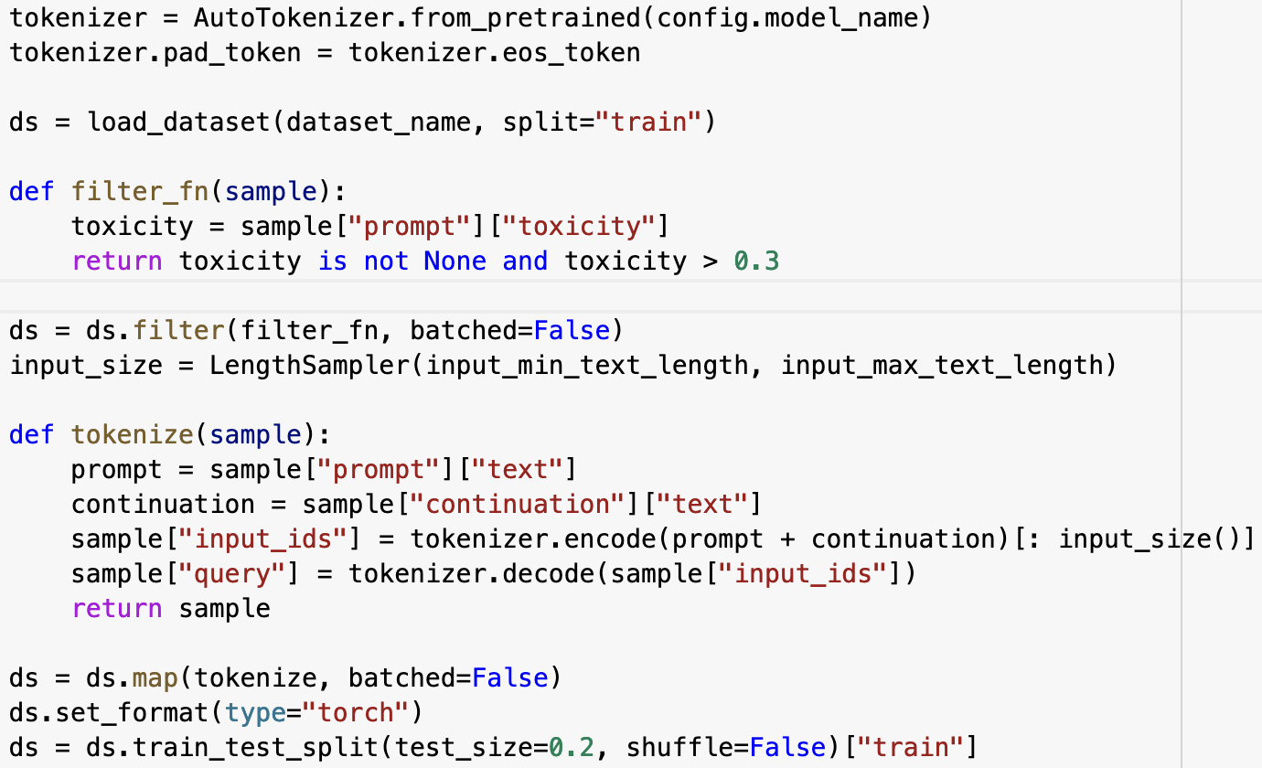
We want to use prompts that will likely generate toxic text, so we filter them…
Assume 0.3 is empirically derived?
Notes:
We don’t want our model never generating toxic text, here we want to generate it all the time so we can fix it via RLHF

Slide 52
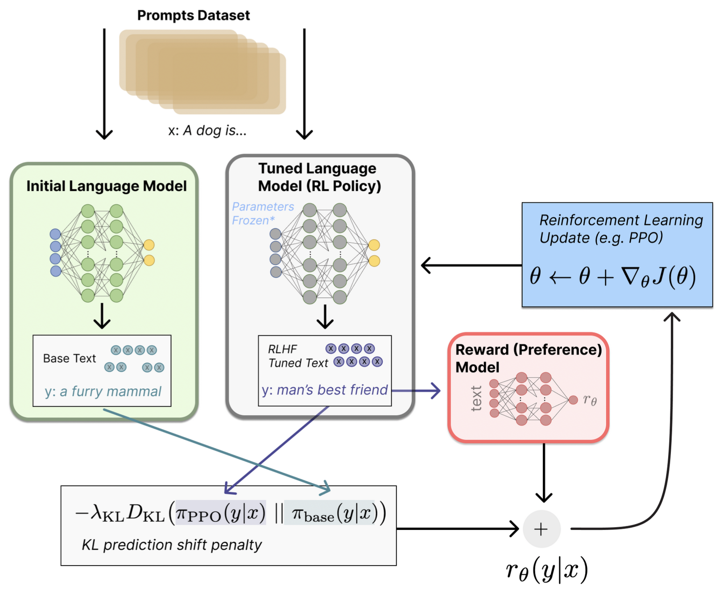
PPO is Proximal Policy Optimization
Can run in parallel
Is “on policy” meaning parameters are only updated with the current batch of prompt-generation pairs instead of keeping any sort of buffer
Notes:
Based on earlier work by Stiennon et al (2020) on learning to summarize from human feedback
InstructGPT did add additional pre-training gradients (from the human annotation set)
Other tricks, actually uses gradients from PPO-ptx (in InstructGPT) since they discovered their model was doing bad on NLP tasks, wanted to keep original values
-Don’t have to use PPO (older algorithm), DeepMind uses another totally different algorithm (Advantage Actor Critic), actually uses 2 reward models, 1 for human preference and one for checking if rules have been broken

Slide 53
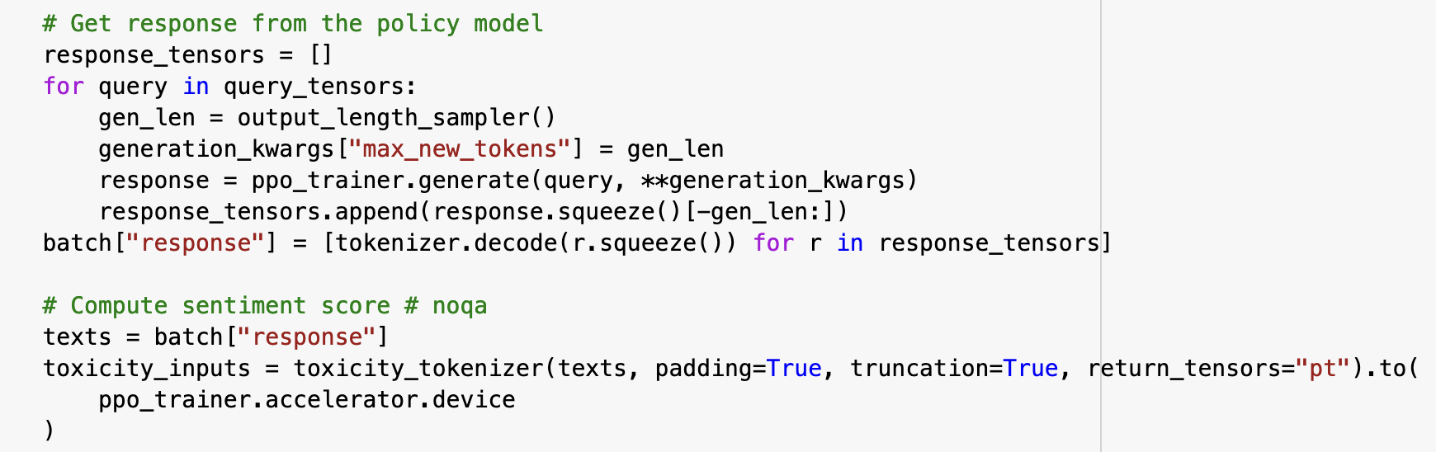
Response and Reward
ppo_trainer holds references to both the baseline model and the target model to be fine-tuned with RHLF
Both models will generate continuations up to max_new_tokens in response to the prompt

Slide 54
KL Divergence is distance between distributions
Goal with KL Divergence is to make sure the model you are doing (RL Policy) is not producing very different output from the original model
Don’t want garbage text that fools reward model but is junk
Penalized on a per-token basis, approximated through sampling
Notes:
Initial Language Model (pre-trained earlier, fine-tuned with initial human generated prompts and text)
Reward Model (Text In -> Scalar Out) – just another LLM
Tuned Language Model (RL Policy)
KL divergence more complicted in InstructGPT not shown here, but they basically have a PPO-ptx model where they mix in the gradients of the pre-trained (initial) language model to avoid lower performance on various NLP tasks
J(theta) is expected reward, minimize the negative reward (use the ratio of the new probability to the old probability)

Slide 55
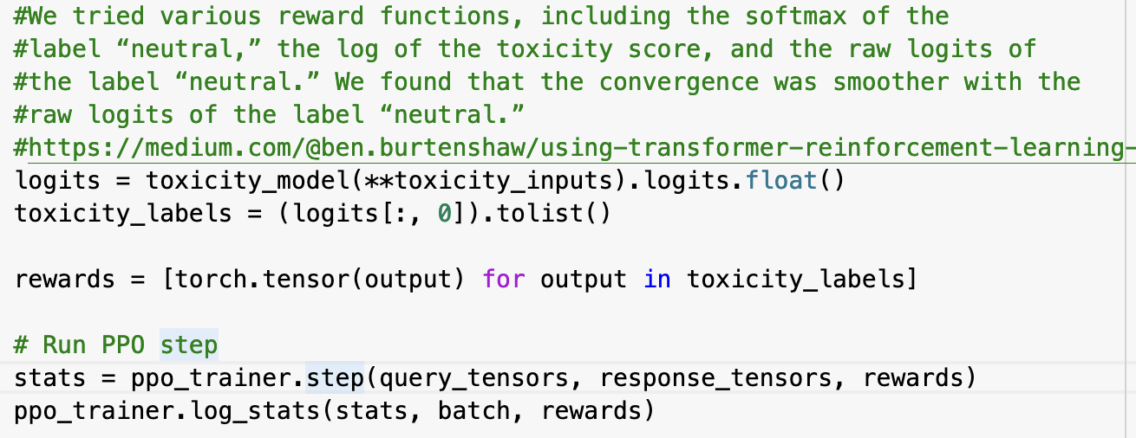
Model Update
Notes:
Logits worked the best per blog as a reward, specifically the ‘neutral’ (not toxic) ones
The .step function is where model is updated, KL divergence calculated, etc…
Training was truncated

Slide 56
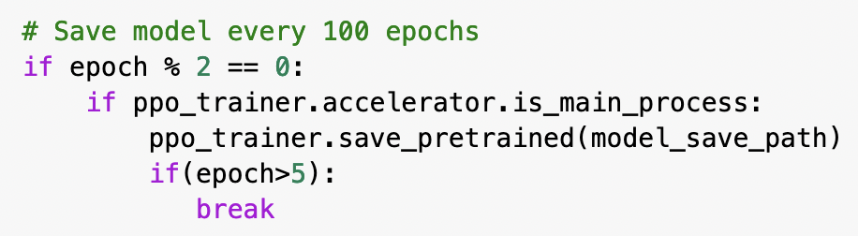
How much data is required for optimization?
Depends on how hard the problem is
Less than pre-training but more than supervised training?
Examples
WebGPT 20K
InstructGPT 55K
Anthropic “Claude” 200K
Don’t take the above seriously!
Did not have time (developer time or Colab time) to train with all examples..
Better approach: checkpoint models and compare on validation data

Slide 57
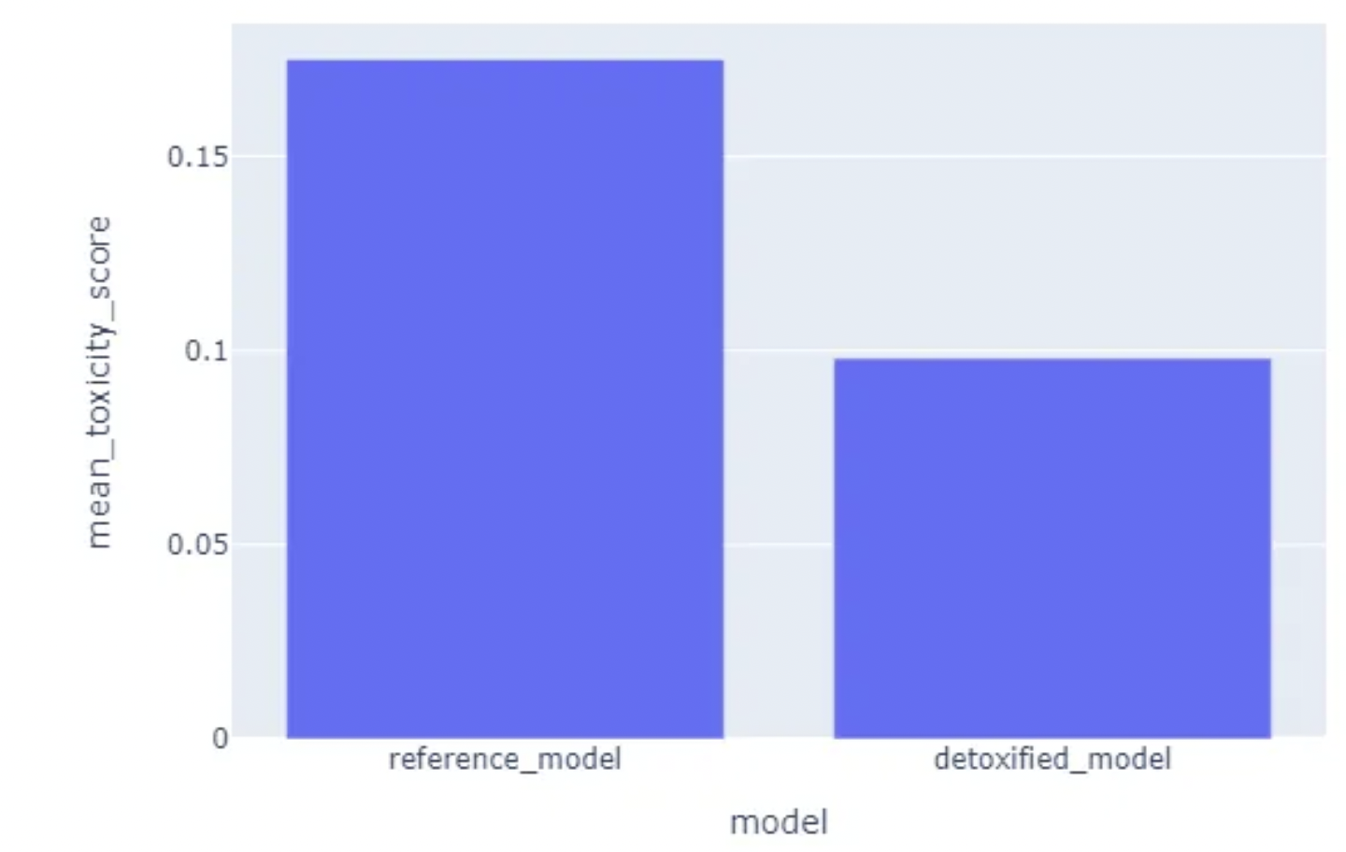
Manual annotation of 250 examples
After RLHF, model went from 15% toxic to 10% toxic
https://medium.com/@ben.burtenshaw/using-transformer-reinforcement-learning-to-detoxify-generative-language-models-5198446d6786

Slide 58

The Future
Increasing importance of training data especially open data
LLaMA & Alpaca
Legal & ethical implications
Smaller yet fully functional models
LoRA
Multimodality
GPT-4
AutoGPT
Healthcare Applications
Notes:
More efficiency (folks are well aware of environmental and energy costs)

Slide 59
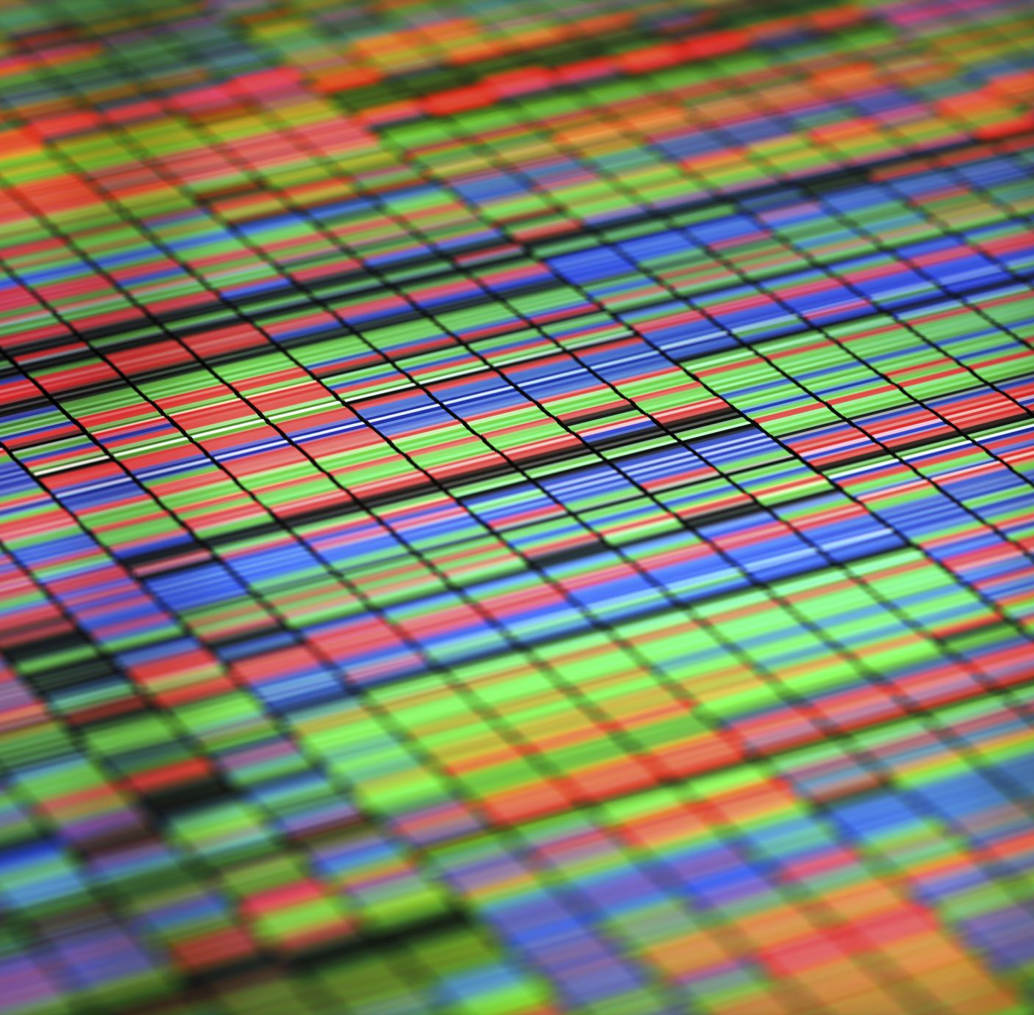
Data

Slide 60
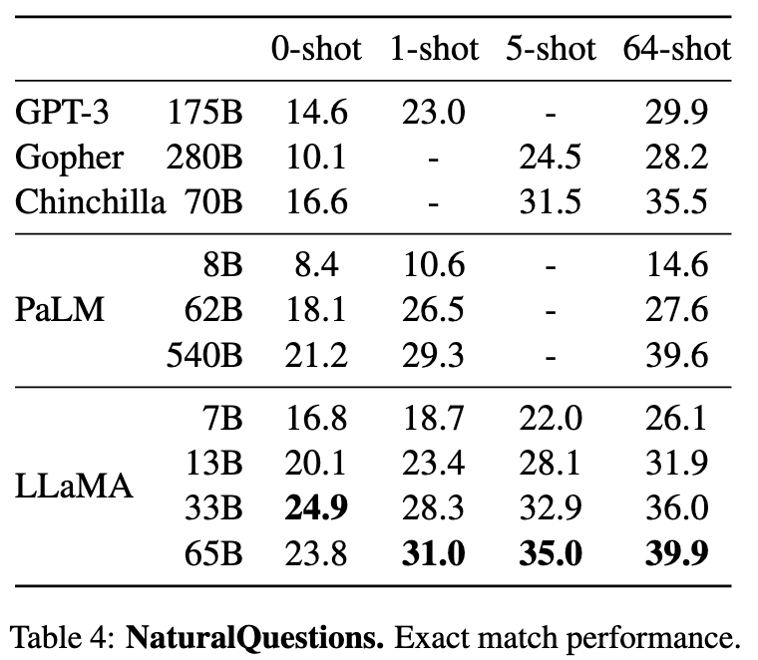
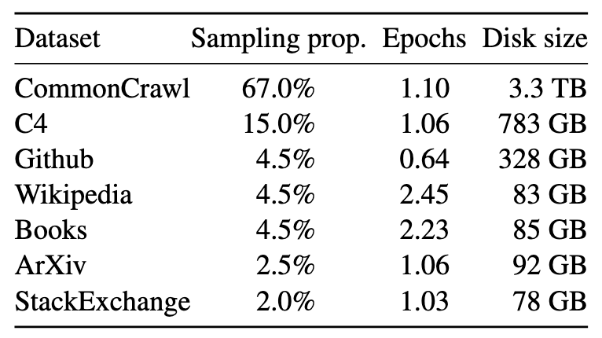
LLaMA (Large Language Model Meta AI)
Tables from https://arxiv.org/pdf/2302.13971.pdf
Experimented training with more data rather than having a larger model
https://github.com/facebookresearch/llama
Notes:
Wide variety of PUBLIC data
Large models still perform better, but smaller models (on this task, others not shown) are competitive with additional training
Less costly inference
Quantization process going on here too, shrinking down models from fp16 to int4, doesn’t actually hurt large language models as much as you would shrink

Slide 61

Alpaca
https://crfm.stanford.edu/2023/03/13/alpaca.html
Notes:
LLaMA shows how important data is, Alpaca shows importance of publicly accessible data
-they used Self-Instruction to get their data set (not going to talk about) but they claim they got their data for ~ $500 using this method
-this (unlike Meta data) has been made publicly available

Slide 62

News article from yesterday
“Exclusive” article was deep fake
Michael Schumacher in a coma from ski accident
Only mention at end of the article it was generated with AI
Implications for healthcare?
https://www.reuters.com/sports/motor-sports/schumacher-family-planning-legal-action-over-ai-interview-2023-04-19/
Notes:
Ethical issues here, do you own derivative works from your own data? Nothing is clear but IANAL
Easy interviews for journalists
What does this matter for healthcare? Lots…

Slide 63

AMIA NLP Working Group Email
Notes:
May be of interest to people, my lab not the only one on campus who is using MIMIC data
Unclear what DUA covers?
For example, student in my lab fine-tuned a language model with MIMIC data in order to generate synthetic training data. Can we distribute this synthetic data? I think so, but probably should ask lawyer

Slide 64

Smaller and more efficient models

Slide 65

LoRA: Low-Rank Adaptation
Reduce trainable parameters by a factor of 10,000 vs GPT-3 175B
Do NOT update pretrained weights W₀ ! Learn BA instead.
W₀ + ∆W = W₀ + BA, where B ∈ R^{d×r} , A ∈ R^{r×k}
Compute low rank approximation (could be as small as 2)
Equivalent performance
Notes:
LoRA been around for awhile (October 2021) but now we have big public data…
Compute via Singular Value Decomposition (SVD), with M = USV, U is complex unitary matrix, diagonal matrix S of singular values, V* is conjugate transpose of V
Unitary if conjugate transpose is also its inverse (multiply to get identity)
-reduced rank approximiation is found by reducing ALL by the first k singular values to zero, you can set this as part of your configuration
-less information should be worse? However, you just may be eliminating a bunch of noise

Slide 66

LoRA Results
https://github.com/microsoft/LoRA

Slide 67


High-throughput Generative Inference of Large Language Models with a Single GPU
Sheng, Ying, et al. "High-throughput Generative Inference of Large Language Models with a Single GPU." arXiv preprint arXiv:2303.06865 (2023).
https://github.com/huggingface/peft
Notes:
-just inference here, but inference is important (even if training gets the attention) because inference time is when the model is used
-means you may have the ChatGPT equivalent on your cell phone
Series of different techniques
-pushing some computation to GPU

Slide 68

Optional Mini-Demo
“This combines the LLaMA foundation model with an open reproduction of Stanford Alpaca a fine-tuning of the base model to obey instructions (akin to the RLHF used to train ChatGPT) and a set of modifications to llama.cpp to add a chat interface.”
https://github.com/antimatter15/alpaca.cpp

Slide 69

Context Window
Notes:
Also known as sequence length
How many tokens can a transformer give full attention to (lots of efforts to expand this BigBird, Longformer)

Slide 70
Notes:
Context Length – Sequence Length – Window Size
-allow for huge reasoning boost

Slide 71

GPT-4
https://www.forbes.com/sites/bernardmarr/2023/02/24/gpt-4-is-coming--what-we-know-so-far/?sh=5a5c86546c2d
Notes:
Forbes Magazine cover

Slide 72
GPT-4
“Given both the competitive landscape and the safety implications of large-scale models like GPT-4, this report contains no further details about the architecture (including model size), hardware, training compute, dataset construction, training method, or similar”
Capabilities however are detailed in technical and available to use with GPTPlus subscription
https://cdn.openai.com/papers/gpt-4.pdf

Slide 73

Table 2. Performance of GPT-4 on academic benchmarks. We compare GPT-4 alongside the best SOTA (with benchmark-specific training) and the best SOTA for an LM evaluated few-shot. GPT-4 outperforms existing LMs on all benchmarks, and beats SOTA with benchmark-specific training on all datasets except DROP. For each task we report GPT-4’s performance along with the few-shot method used to evaluate. For GSM-8K, we included part of the training set in the GPT-4 pre-training mix (see Appendix E), and we use chain-of-thought prompting [11] when evaluating. For multiple-choice questions, we present all answers (ABCD) to the model and ask it to choose the letter of the answer, similarly to how a human would solve such a problem.
https://openai.com/research/gpt-4
Notes:
Not just vision
“The model’s capabilities on exams appear to stem primarily from the pre-training process and are not significantly affected by RLHF. “
“responses generated by GPT-4 were preferred over the responses generated by GPT-3.5 on 70.2% of prompts”
-hundreds? of authors

Slide 74


Notes:
Multi-modality here is just image and text
Future is video (already stuff out there) which has big implications for robotics

Slide 75


Slide 76

Possible Health Care Applications
Training (and cheating)
Summarization and Chart Review
Billing and Coding
Draft letter recommendation letter
Insurance Pre-approval / Notes
Systematic Reviews
Paper editing including translation
Robots (multi-modality)
Notes:
Writing computer code (Copilot)

Slide 77
Last Application: Doing your talk for you?
“Create text for presentation slides discussing RLHF that can be copied and pasted into PowerPoint. The target audience is PhD/Masters/postdoc trainees interested in learning AI.”
See https://github.com/u-brite/rlhf_attis2023/blob/main/RLHF_ChatGPTGeneratedTalk.docx in tutorial repository
Let me know if I am out of a job!
Notes:
Would be nicer with GPT-4 multi-modal presentation
Would like be mostly stolen! ☺

Slide 78
Credits and Discussion
Hugging Face and TRL project
https://huggingface.co/blog/rlhf
Shan Chen
GPT-2/GPT-3 Information

Slide 79
END

Slide 80
Unused Slides

Slide 81

Text to Image
Prompt:
“A roomful of scientists discussing large language models and reinforcement learning with human feedback at the University of Alabama at Birmingham”
“Abstract World” style
https://starryai.com

Slide 82
“Can you explain how RLHF works for language models like I am an undergraduate student?”
Sure! Reinforcement Learning with Hybrid Forward models (RLHF) is a technique used to improve the performance of language models by combining different types of models and using reinforcement learning to optimize their performance.
Let's start with some background information. Language models are algorithms that are trained to predict the probability of a sequence of words. They are typically trained using a technique called supervised learning, where the model is given a large dataset of text and learns to predict the next word in a sentence based on the previous words.
However, supervised learning has limitations. It can only learn from the specific examples it is given, and it struggles with situations that it has not seen before. This is where reinforcement learning comes in.
Reinforcement learning is a type of machine learning where the model learns by interacting with an environment and receiving feedback in the form of rewards or punishments. In the context of language models, the environment is the text that the model is generating, and the reward is a measure of how good that text is.
Now, let's talk about hybrid forward models. These are models that combine multiple types of models to generate text. For example, a hybrid forward model might combine a recurrent neural network (RNN) with a transformer model. The RNN would generate text one word at a time, while the transformer would take into account the entire context of the text.
The idea behind RLHF is to use reinforcement learning to optimize the performance of a hybrid forward model. The model is trained to generate text that maximizes a reward signal, which is a measure of how good the text is. The reward signal is typically based on some external criteria, such as the relevance or coherence of the text.
During training, the model generates a sequence of words, and the reward signal is computed based on the quality of the generated text. The model then adjusts its parameters to maximize the reward signal, using techniques such as gradient descent.
One benefit of RLHF is that it can handle situations where the model is unsure of what to do next. For example, if the model is generating text and it encounters a rare or unusual word, it may not know how to proceed. RLHF allows the model to learn from its mistakes and adjust its behavior accordingly.
In summary, RLHF is a technique that combines reinforcement learning and hybrid forward models to improve the performance of language models. It allows the model to learn from its mistakes and adjust its behavior based on feedback from its environment.

Slide 83

Calculate the loss given the formula loss = -min(ratio * R, clip(ratio, 0.8, 1.2) * R), where R is the reward + KL (or a weighted average like 0.8 * reward + 0.2 * KL) previously computed and clip(ratio, 0.8, 1.2) is just bounding the ratio to be 0.8 <= ratio <= 1.2. Note that 0.8/1.2 are just commonly used hyperparameter values that are simplified here. Also not that we want to maximize the reward, that's why we add the minus -, so that we minimize the negation of the loss with gradient descent.
https://gist.github.com/JoaoLages/c6f2dfd13d2484aa8bb0b2d567fbf093

